Slide 1

Membership Inference Attacks on Sequence Recommender Systems
COMP 6480
University of Memphis
Professor Xiaolei Huang
Huan Zhao (U00879231), Jiaqi Xu (U00787062)
Dec 2024

Slide 2
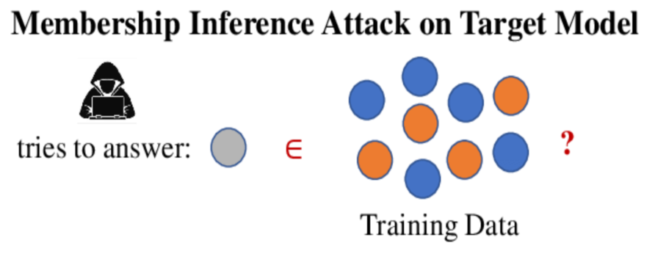
Motivation
Membership Inference Attacks (MIA) are a serious threat to recommender systems because they can reveal if a specific user's data was included in the model's training set, leading to privacy concerns.
For example, in a video streaming platform, a vulnerable recommender system could allow an attacker to determine if a user has viewed certain sensitive or stigmatized content. By identifying individuals who interacted with specific items, the attacker could infer private details about users' preferences, behaviors, or even their identities, posing a serious risk to user privacy.
In order to protect our privacy, we need to carry research on how to inial MIA over a model.
Notes:
motivation

Slide 3
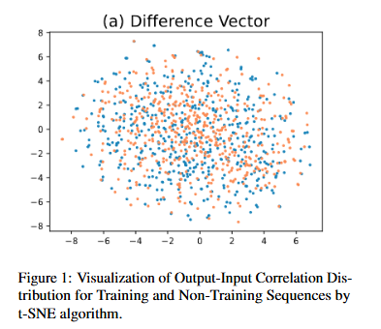
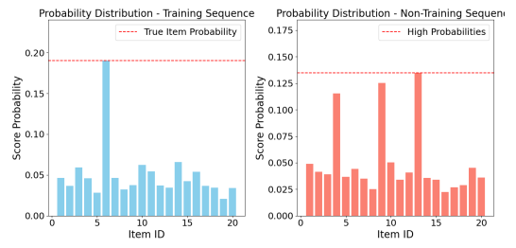
insight
Traditional MIA methods don’t work well on sequential recommendation models because these models generalize well (as shown in left picture), making the outputs for training and non-training data very similar. This makes it hard to tell training data apart from non-training data.
To address this, we use overfitting to create noticeable differences in the distributions of training and non-training data. Our method balances the data between training and non-training sequences, intentionally overfits a transformer model as the target model to highlight these differences and trains a binary classifier (attack model) to detect whether a sequence was part of the training set. We tested our approach using standard metrics, showing that it is accurate in identifying training data.
Notes:
motivation

Slide 4

Current Challenges
Challenge 1: Complexity in Data Processing and Feature Engineering
Recommender systems need to extract meaningful features from large-scale raw user behavior data, such as time series information and item interaction history. The data is massive and highly complex, making direct processing difficult. Feature engineering tasks like normalization, noise reduction, and grouping/aggregation are necessary but can be inefficient with traditional methods, especially for large datasets.
Challenge 2: Training Complexity in Sequential Recommendation Models
Sequential recommendation systems must capture temporal dependencies in user behavior, such as how recent purchases influence future actions. This requires models with strong expressive power to handle long sequences and make accurate predictions. Traditional approaches often struggle to capture patterns in sequential user behavior, particularly for next-item recommendations.
Challenge 3: Model Evaluation and Scalability
Recommender system models need to be fine-tuned and evaluated across different time windows to ensure their effectiveness in real-world scenarios. Managing this process efficiently while maintaining scalability is a significant challenge.

Slide 5
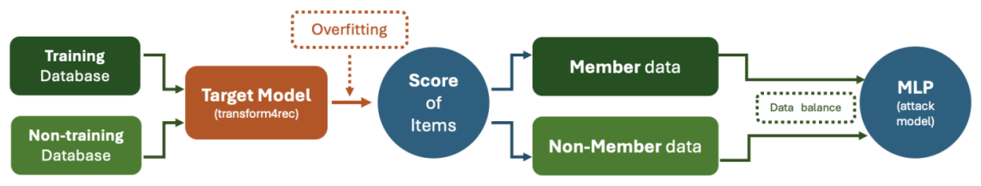
Method Structure
+NVTabular logo
+transformer4rec
+attack model

Slide 6
Advantages of NVTabular
NVTabular is a library specifically designed for recommendation systems and large-scale data processing. Compared to traditional data processing methods, it offers the following significant advantages:
GPU Acceleration
Provides high-performance computing for large-scale data processing using NVIDIA GPUs.
Example: Operations like Categorify and Normalize are tens of times faster compared to CPU-based methods.
Comparison: Traditional tools like Pandas or scikit-learn are slower and prone to memory crashes when handling large datasets.
Modular Workflow
Advantage: Workflows and ColumnSelectors allow feature processing steps to be defined as pipelines, making the logic clear and the code reusable.
Comparison: Traditional methods require manual chaining of steps, leading to high coupling and difficulty in maintenance.
Automated Global Statistics Calculation
Advantage: NVTabular automatically calculates global statistics (e.g., mean, standard deviation) in chunks, eliminating the need for manual sampling or full-dataset computations.
Comparison: Traditional methods require manual computation of statistics, which is especially complex in distributed environments.
Data Compatibility
Advantage: Supports multiple data formats, including cudf, Pandas, and Parquet.
Input data can be in CSV or Parquet format, and output supports standardized storage formats, making it suitable for distributed storage and loading.
Comparison: Traditional methods often lack flexibility in input/output formats.
Optimized for Recommendation Systems
Advantage: NVTabular offers modules for common recommendation system feature engineering tasks, such as categorization, temporal features, and item recency calculation.
Comparison: Traditional tools require manual implementation of recommendation-specific logic, resulting in complex and time-consuming code.

Slide 7
transformer4rec
Optimized with NVIDIA Hardware and Libraries
Leverages NVIDIA GPUs, CUDA, and TensorRT for accelerated training and inference.
Seamlessly integrates with NVIDIA Merlin libraries (e.g., NVTabular, HugeCTR) for large-scale data processing.
Supports portable and scalable containerized environments via NVIDIA NGC.
Superior Sequential Modeling
Powered by Transformer architecture, effectively captures long-range dependencies in user behavior.
Supports pretraining and fine-tuning for improved recommendation accuracy.
Flexible for diverse input formats and complex recommendation scenarios.

Slide 8
Dataset & environment
Yoochoose-clicks.dat from Kaggle
contains a collection of sessions from a retailer. Each session encapsulates the click events that the user performed in that session.
popular and accessible public dataset.
Runing environment：paperspace
High-Performance GPU Resources: Access to powerful GPUs (e.g., NVIDIA A100, V100) with pay-as-you-go pricing.
Preconfigured Environments: Ready-to-use deep learning setups with PyTorch, TensorFlow, and Hugging Face.

Slide 9
Code overview
NLP_MIA 1202.ipynb:
load and process the raw data to construct the sequencial data.
train the transformer4rec model.
store the parameters when model overfitting.
attack.ipynb:
construct the mem and nonmem data based on the parameters.
train the attack model.
evaluation the model.

Slide 10
Step 1: Data Preparation
1.1 Download Kaggle Dataset
Install the Kaggle Python package to download datasets from the Kaggle platform.
1.2 Configure Kaggle API Credentials
Create a .kaggle folder and move the API credentials file kaggle.json into it.
Set file permissions and use the CLI to download the specified dataset.
1.3 Import Dependencies
Load necessary libraries such as numpy, pandas, and cudf.
Introduce tools for building recommendation systems, such as nvtabular and merlin.schema.

Slide 11
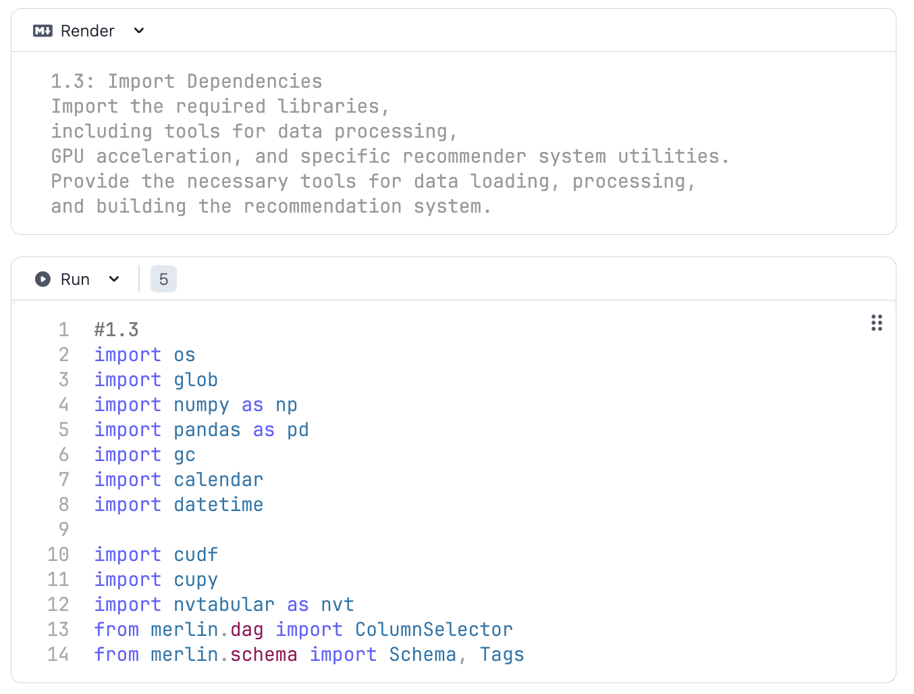
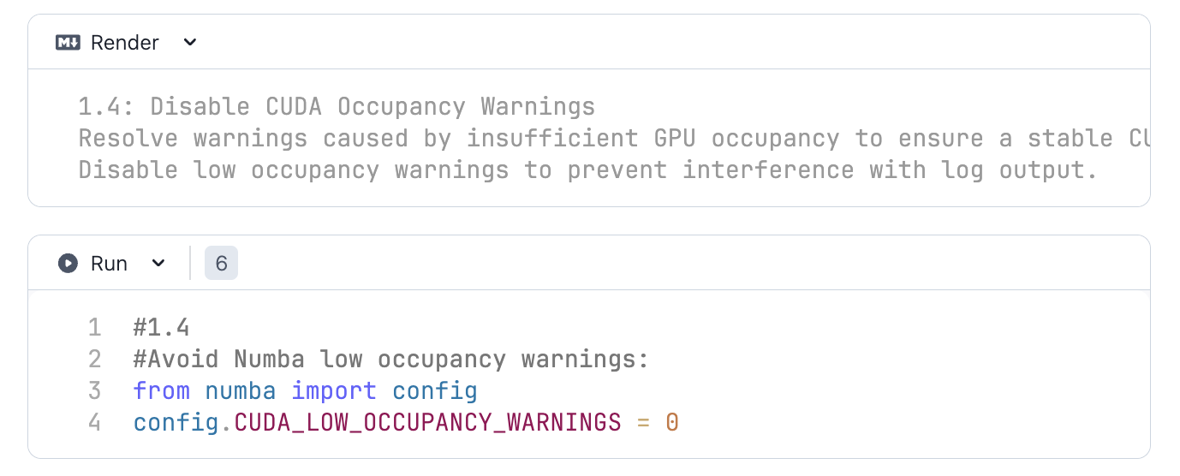

Slide 12
Step 2: Data Loading and Preprocessing
2.1 Load Raw Data
Read the downloaded data file, assign column names, and load it into a pandas or cudf DataFrame.
Conduct initial observation and basic data processing.
2.2 Generate Synthetic User-Item Interaction Dataset
Create synthetic data containing session IDs, item IDs, categories, and timestamps.
Use a log-normal distribution to generate item interaction frequencies, reflecting real-world popularity trends.
Generate datasets of varying sizes and characteristics by adjusting parameters such as date range, number of rows, and distribution.

Slide 13
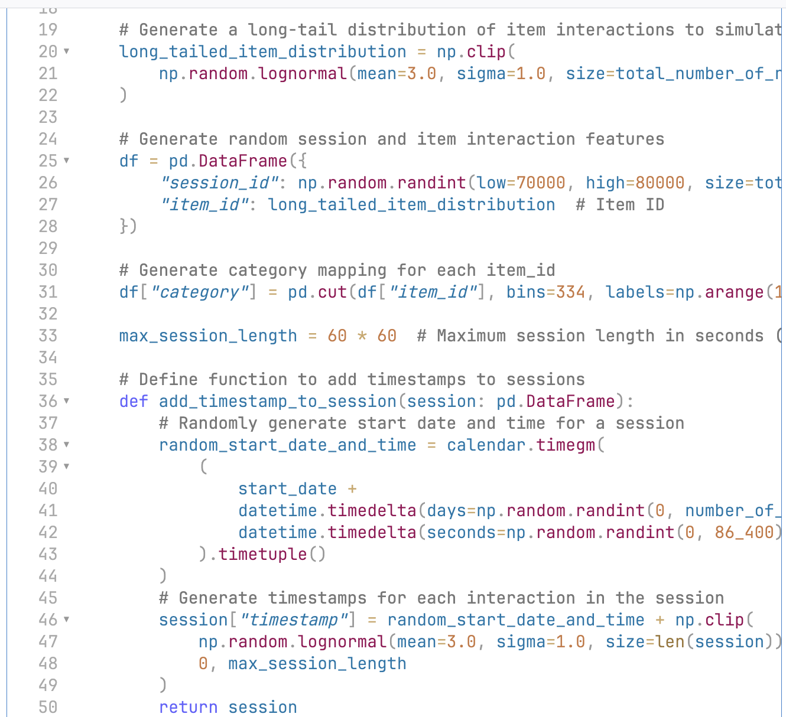
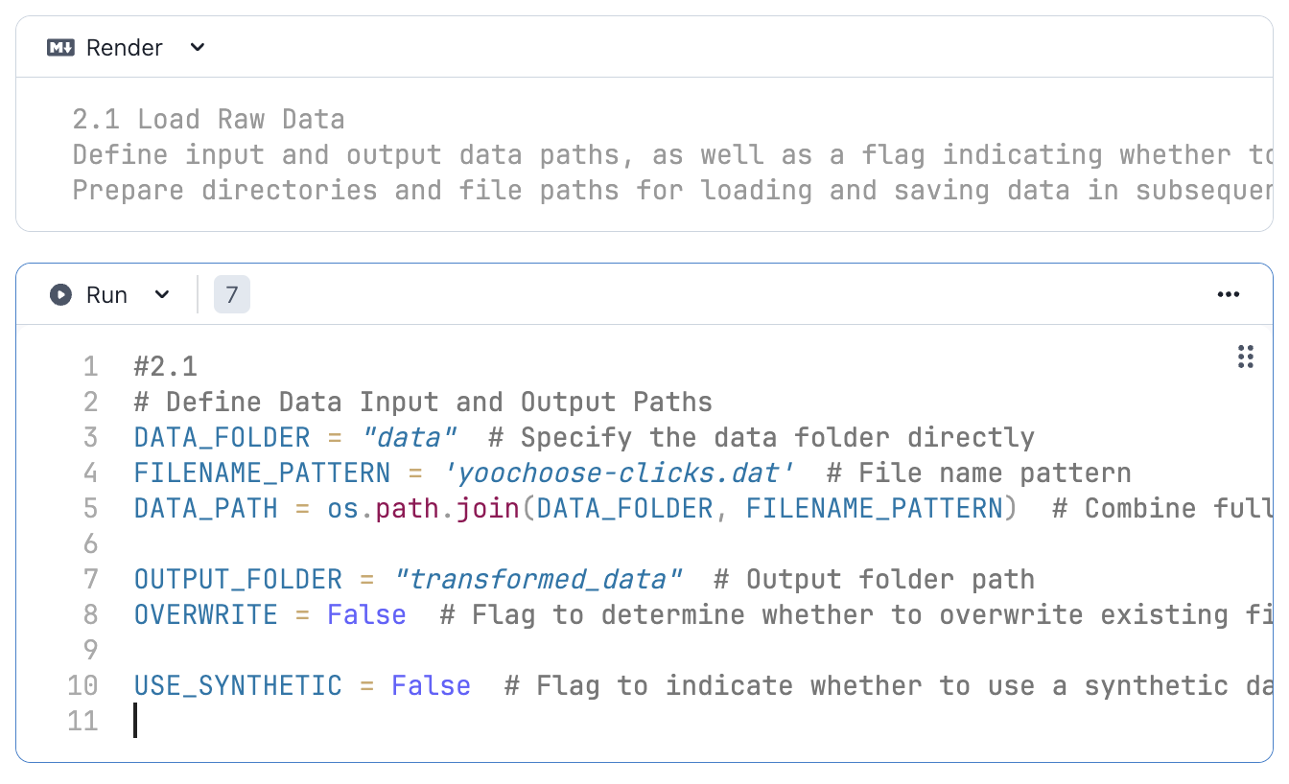

Slide 14
Step 2: Data Loading and Preprocessing
2.3 Load and Clean Data
Dynamically select the data source, supporting seamless switching between synthetic and real data for testing and model development.
Standardize the data structure to ensure that both real and synthetic datasets follow a unified format (e.g., session_id, timestamp, item_id, category).
Efficiently load data as GPU-accelerated cudf DataFrames to enhance preprocessing performance.
2.4 Sort and Deduplicate Data
Sort the data by session and timestamp, create helper columns, and compare current interactions with previous ones.
Remove duplicate item interactions within the same session.
Reduce noisy data and improve data quality using cudf for efficient sorting, filtering, and processing.

Slide 15
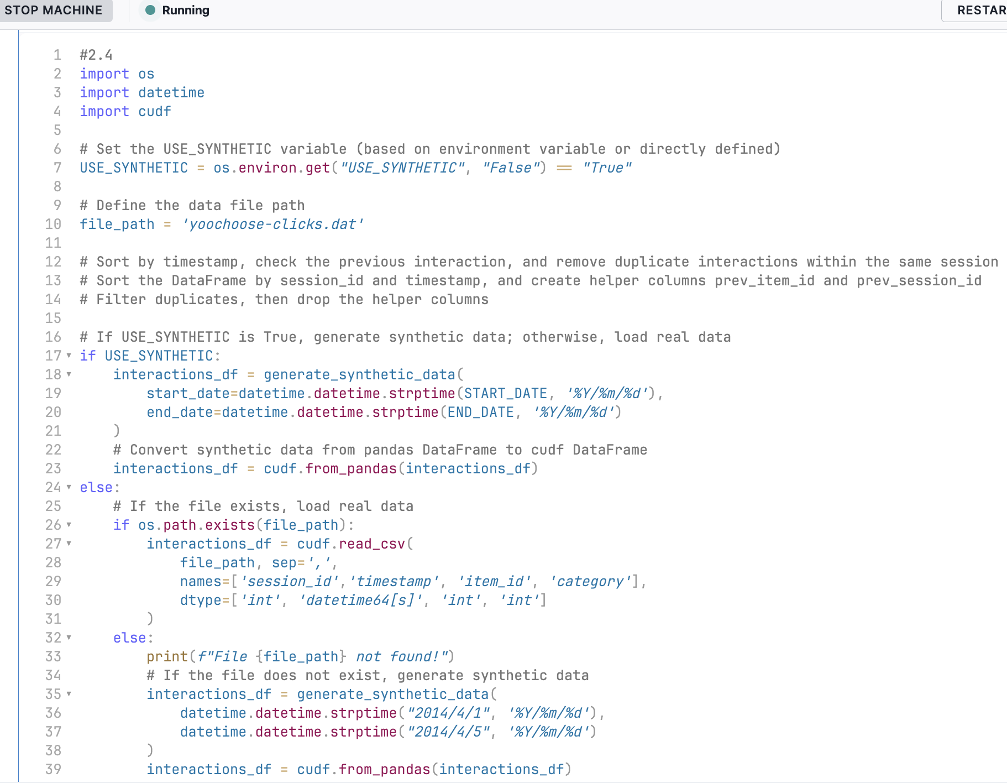
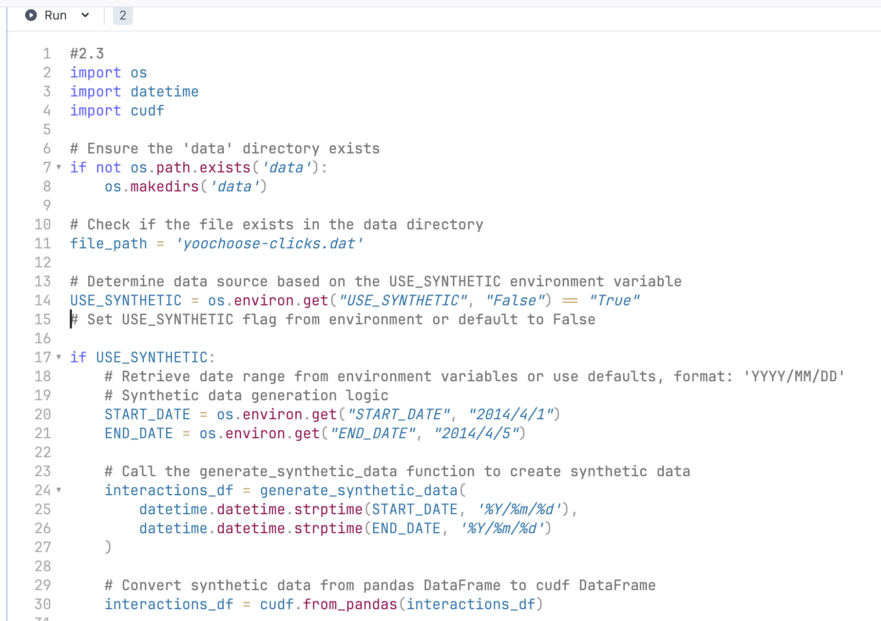
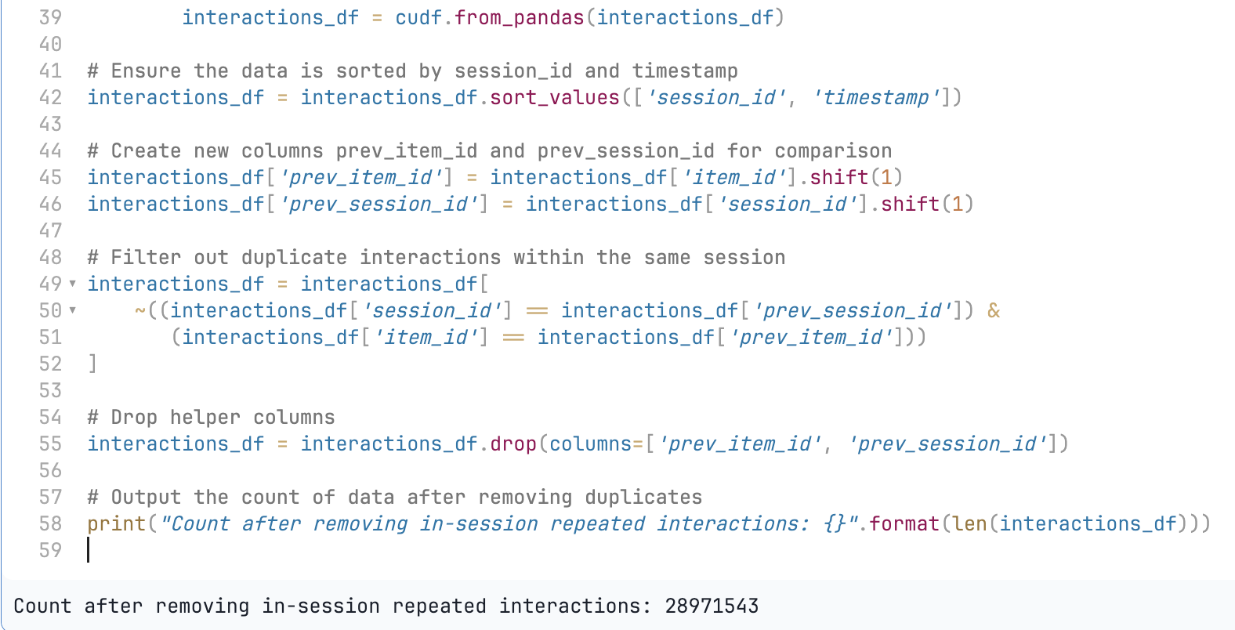
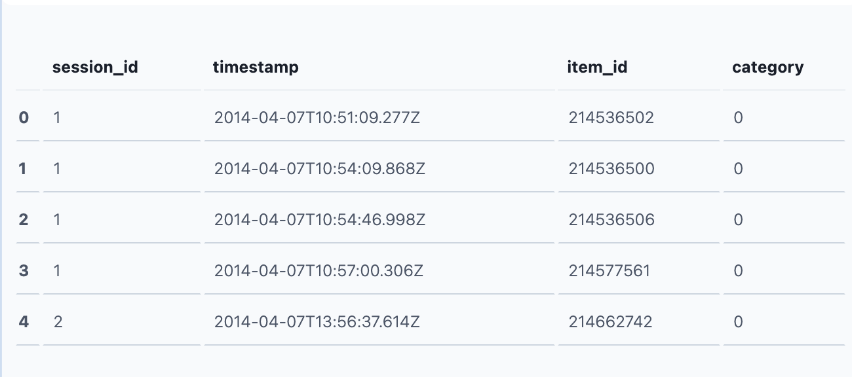

Slide 16
Step 3: Feature Engineering
3.1 Generate Temporal Features
Extract time-related features such as hour, weekday, and the first appearance time of each item.
Create a new feature (itemid_ts_first) that indicates when each item first appeared in the dataset. This feature has the following characteristics:
Global Context: Provides context based on the entire dataset for each item.
Temporal Insights: Reflects the lifecycle or popularity of items.
Contextual Information:
Enhances data representation for subsequent feature engineering or model training.
Flexibility:
Enables time-based analyses, such as new item recommendations or popularity trend analysis.

Slide 17
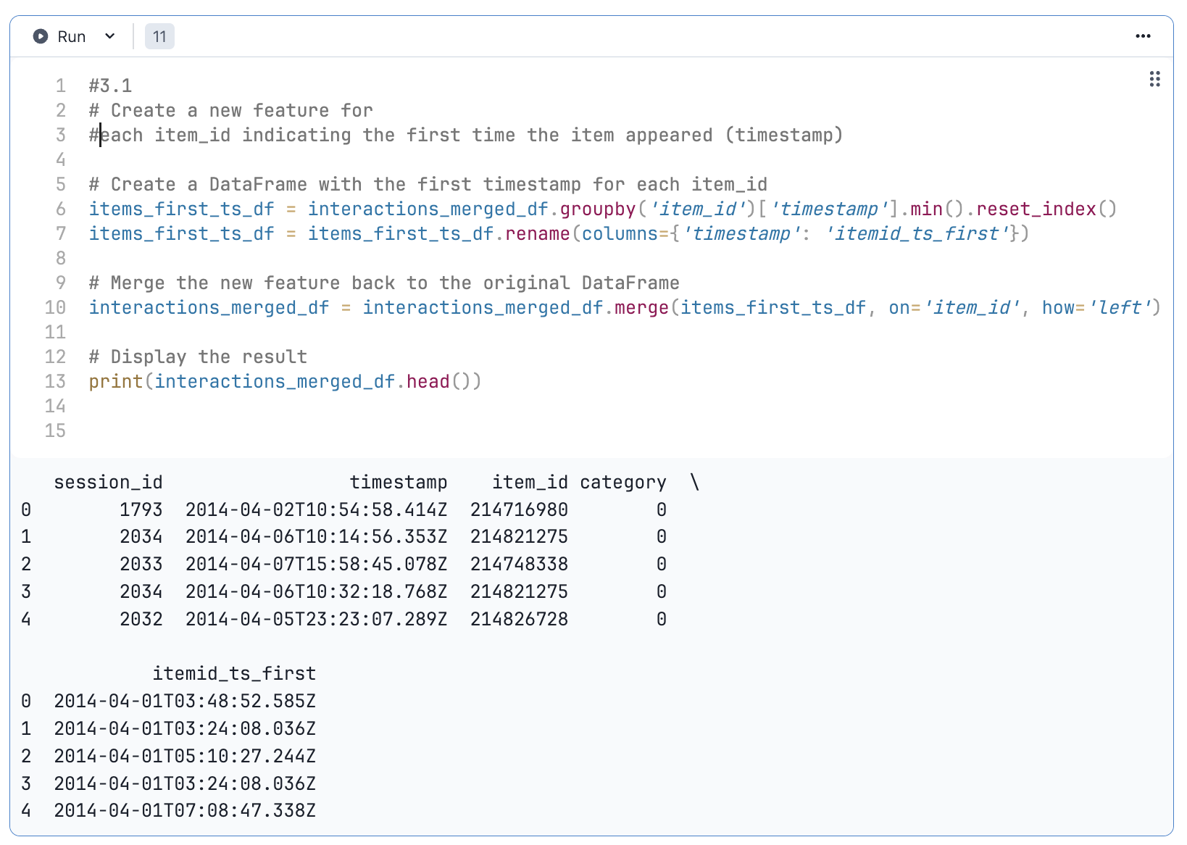

Slide 18
Step 3: Feature Engineering
3.2 Data Format Conversion and Saving
Save the preprocessed data as Parquet files using NVTabular.
Parquet format allows for fast loading and cross-platform usage, supporting compression and partitioning for large-scale data processing.
Persist the data to enhance modularity in the processing workflow.
Count the number of unique items (item_id) in the dataset to understand coverage.
3.3 Clear GPU Memory
Release unused or temporary data during processing, such as raw or cleaned interaction data, session-related variables, and DataFrames storing the first appearance times of items.

Slide 19
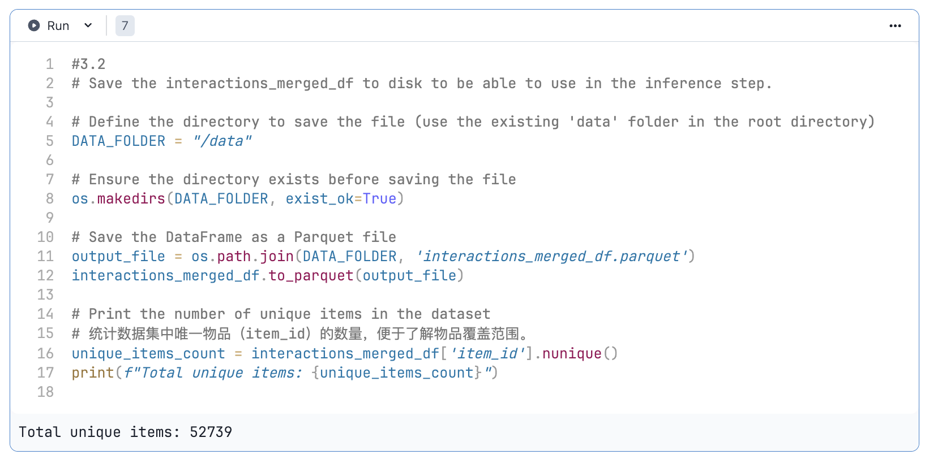
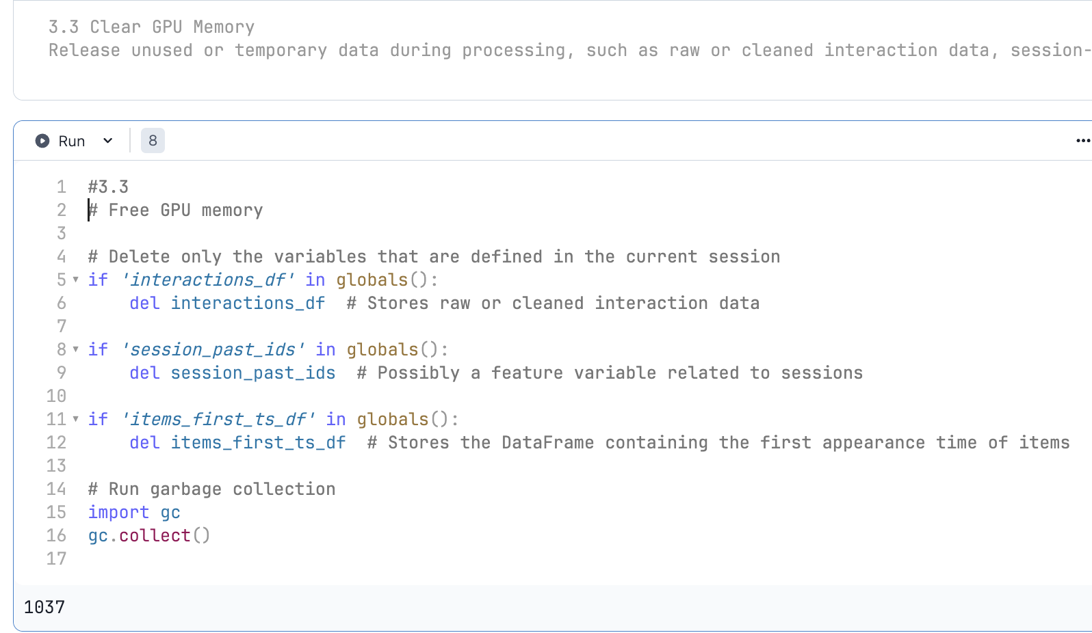

Slide 20
Step 4: Model Construction (Using NVTabular Libraries)
4.1 Define Feature Engineering Workflow
Leverage NVTabular for scalable data processing, including categorical feature encoding, temporal feature construction, item recency calculation, and feature normalization.
Convert timestamps to datetime format and extract weekday using LambdaOp.
Calculate cyclical temporal features for weekdays using a sine function (get_cycled_feature_value_sin).
Create a custom ItemRecency class to compute the number of days between an item's first appearance and the current interaction, storing it as a new feature (_age_days).
Apply logarithmic transformation and normalization to recency features.
Combine all temporal and item-related features into a complete feature set for model training.
Notes:
4.1 Define Feature Engineering Workflow:
This workflow includes steps such as categorical feature encoding, temporal feature construction, item recency calculation, and feature normalization to generate input features for the recommendation system and prepare data for model training.
LambdaOp is used to convert timestamps to datetime format and extract the weekday.
A sine function (get_cycled_feature_value_sin) is applied to compute cyclic temporal features for weekdays.
A custom ItemRecency class calculates the difference in days between an item's first appearance and the current interaction, storing this as a new feature _age_days.
Logarithmic transformation (LogOp) and normalization (Normalize) are applied to the item recency feature.
All temporal and item-related features are combined into a complete feature set, ready for model training.

Slide 21
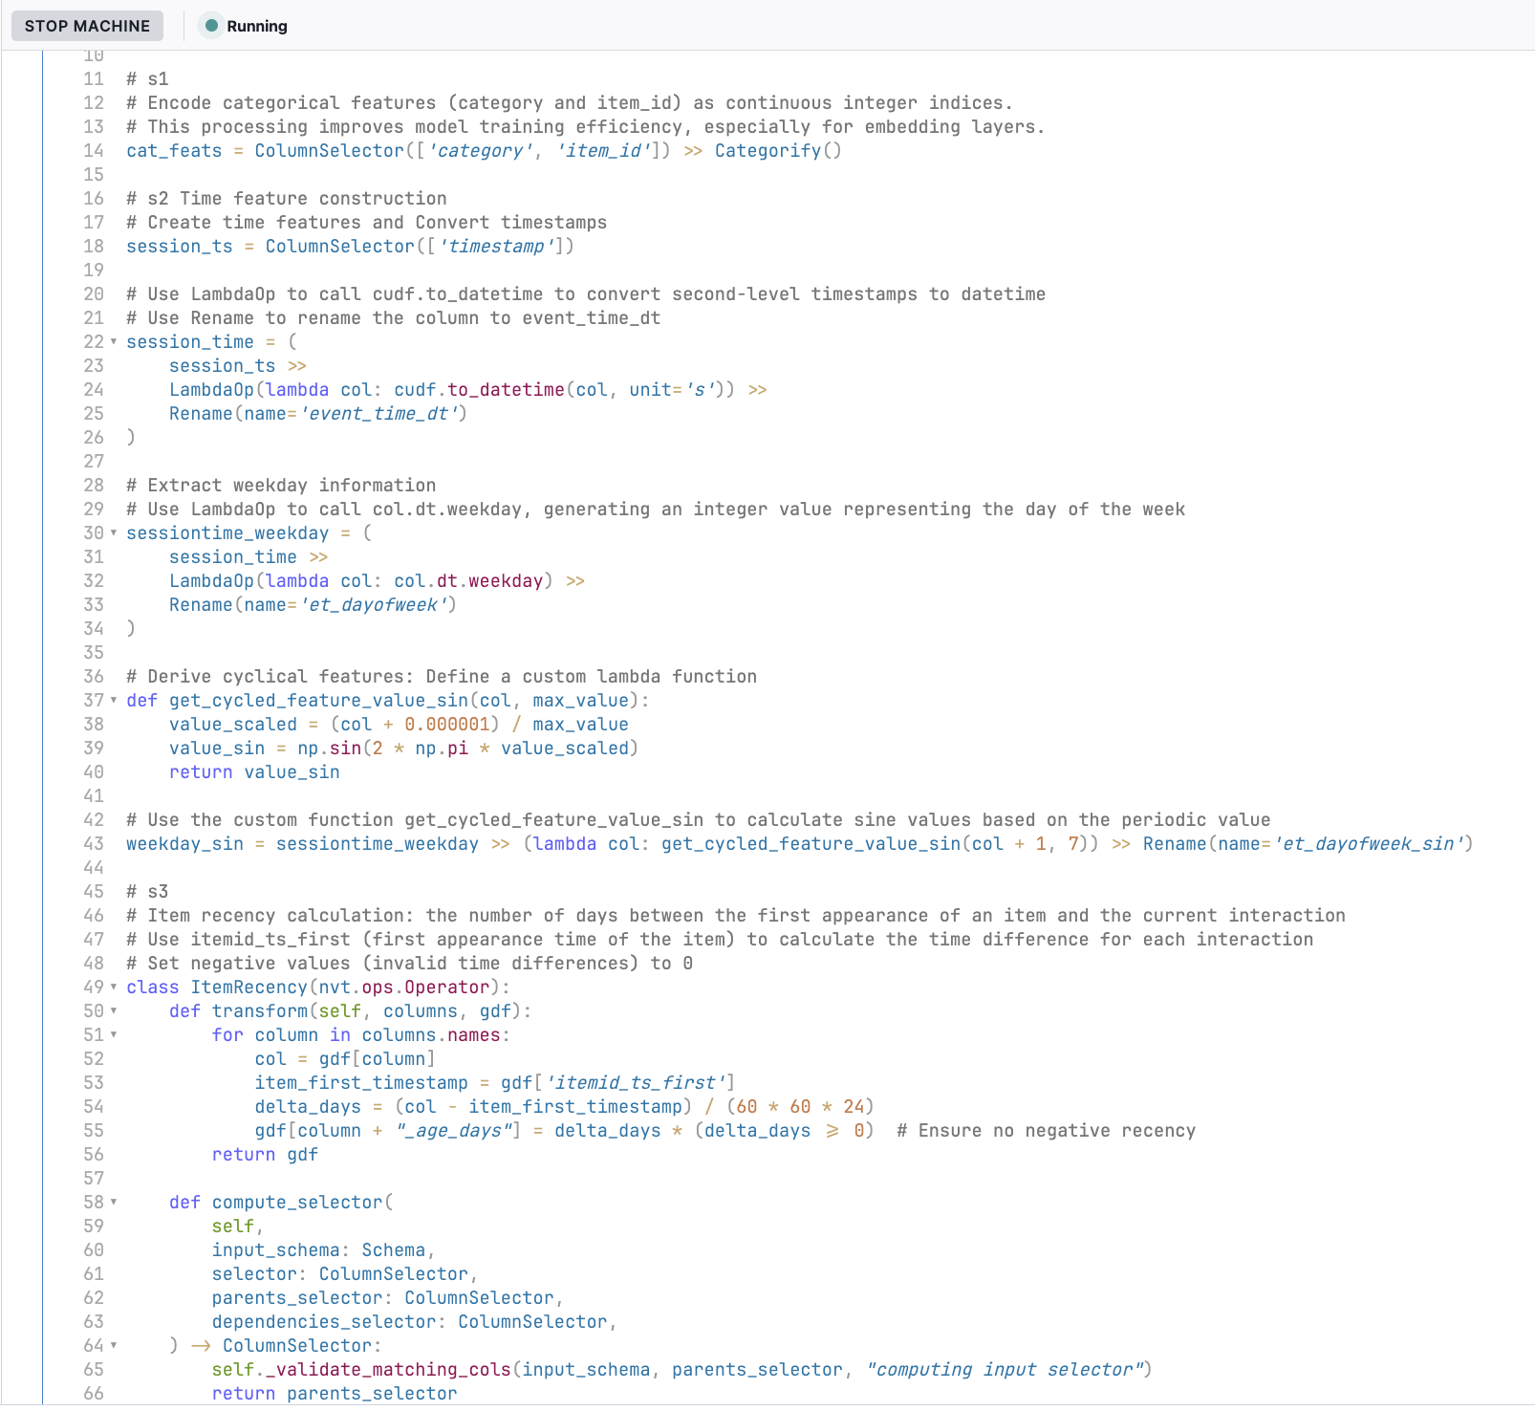
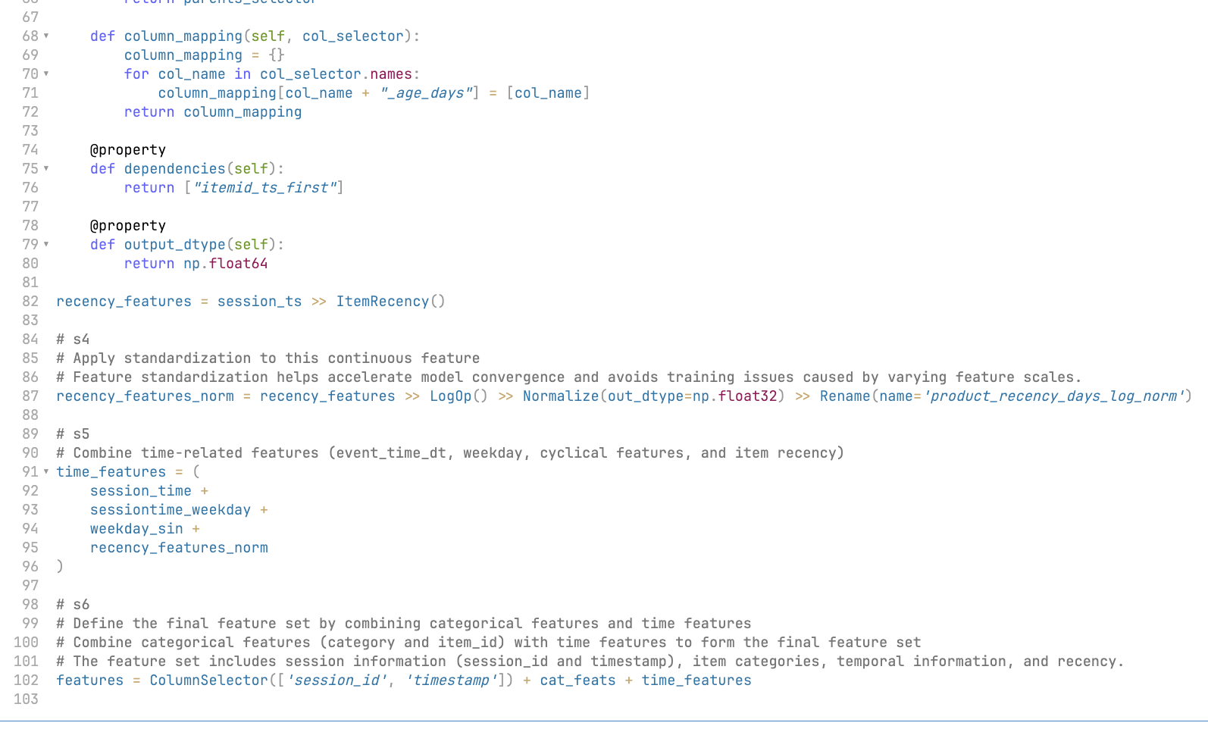

Slide 22
Step 4: Model Construction (Using NVTabular Libraries)
4.2 Groupby Operations and Feature Preprocessing with NVTabular
Perform aggregation, feature generation, and filtering at the session level to create an input feature set suitable for the recommendation system.
Define column selectors and assign labels to items and continuous features, grouping them together.
Truncate sequences, limiting sequence features (e.g., item lists and continuous feature lists) to a fixed length (SESSIONS_MAX_LENGTH).
Filter sessions with fewer than two interactions to ensure data quality.

Slide 23
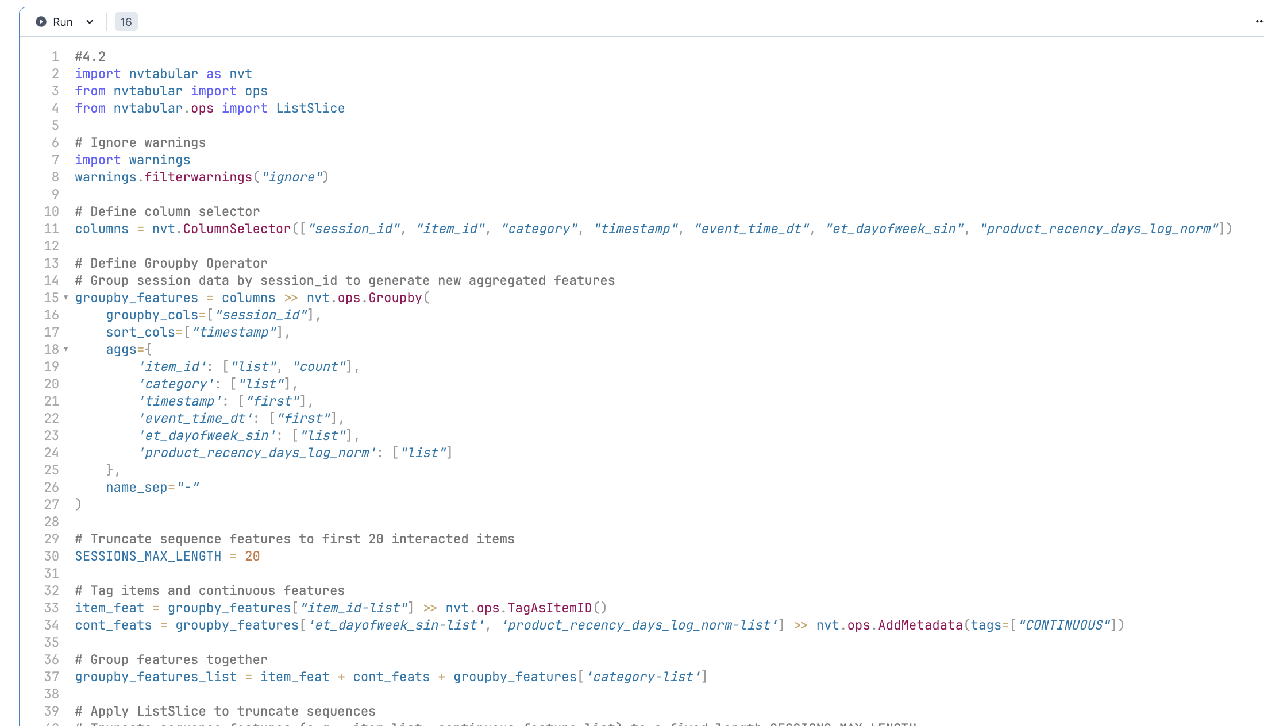
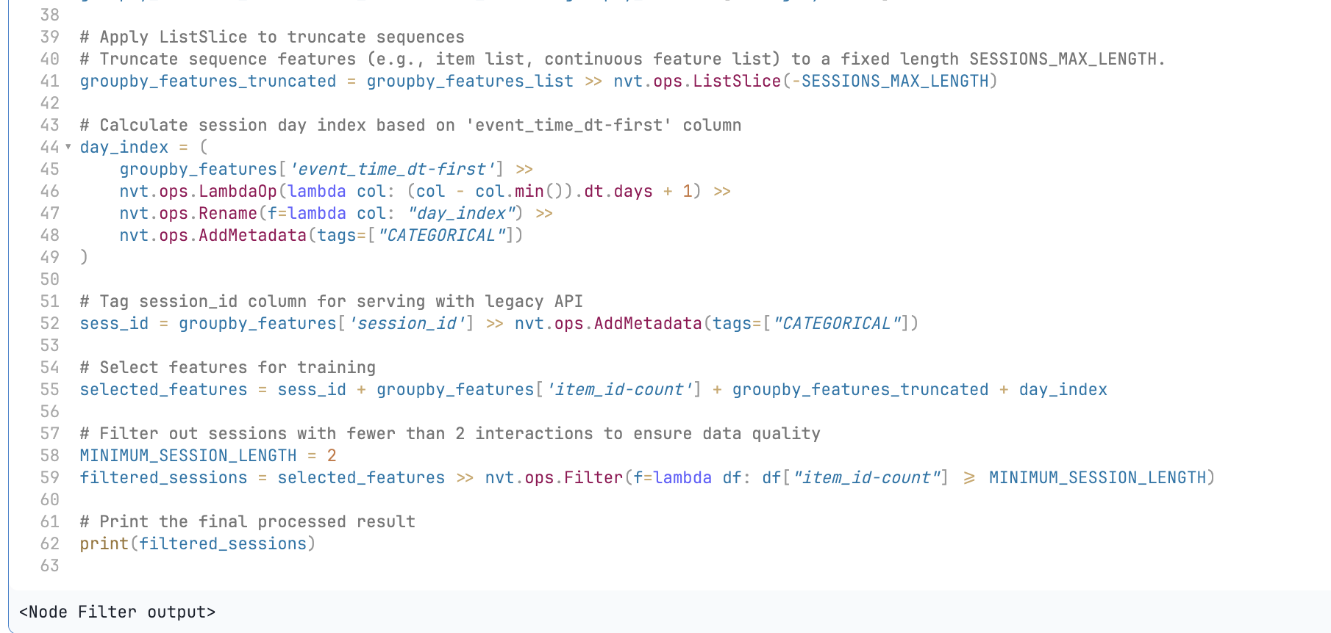

Slide 24

Feature Set Composition:
Session ID (session_id):
Used for associating session context.
Add a CATEGORICAL label for embedding.
Interaction Count (item_id-count):
Measures session activity.
Item List (item_id-list):
Represents the access order of items within a session.
Temporal Features:
Day Index (day_index): Day-based session index.
Cyclical Features (et_dayofweek_sin-list): Temporal cyclic features.
Continuous Features:
Item Recency List (product_recency_days_log_norm-list): Normalized item recency values.

Slide 25
Step 5: Organize Feature Structure
5.1 Data Preprocessing and Feature Construction
Define a complete data preprocessing workflow for generating feature sets required by the recommendation system.
Use NVTabular and cudf for preprocessing, feature engineering, metadata augmentation, and saving.
Output processed data files and feature schema information.

Slide 26
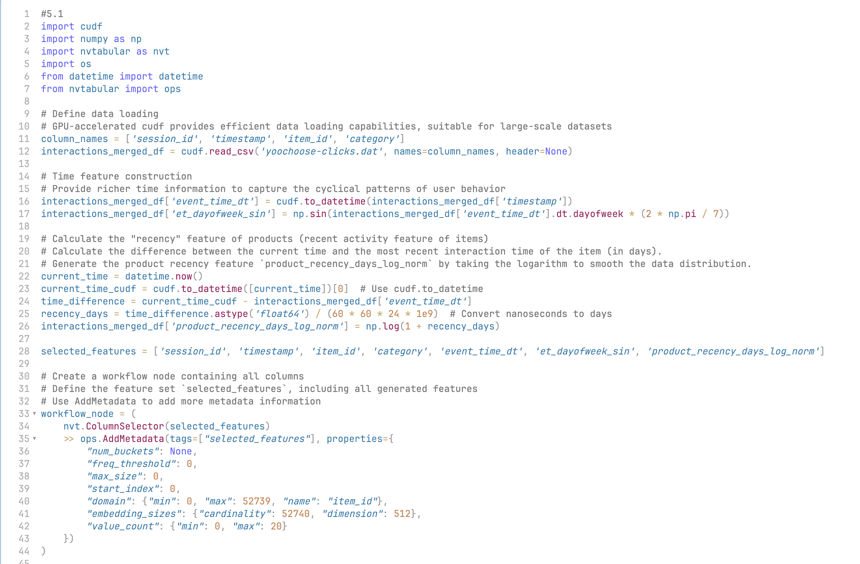
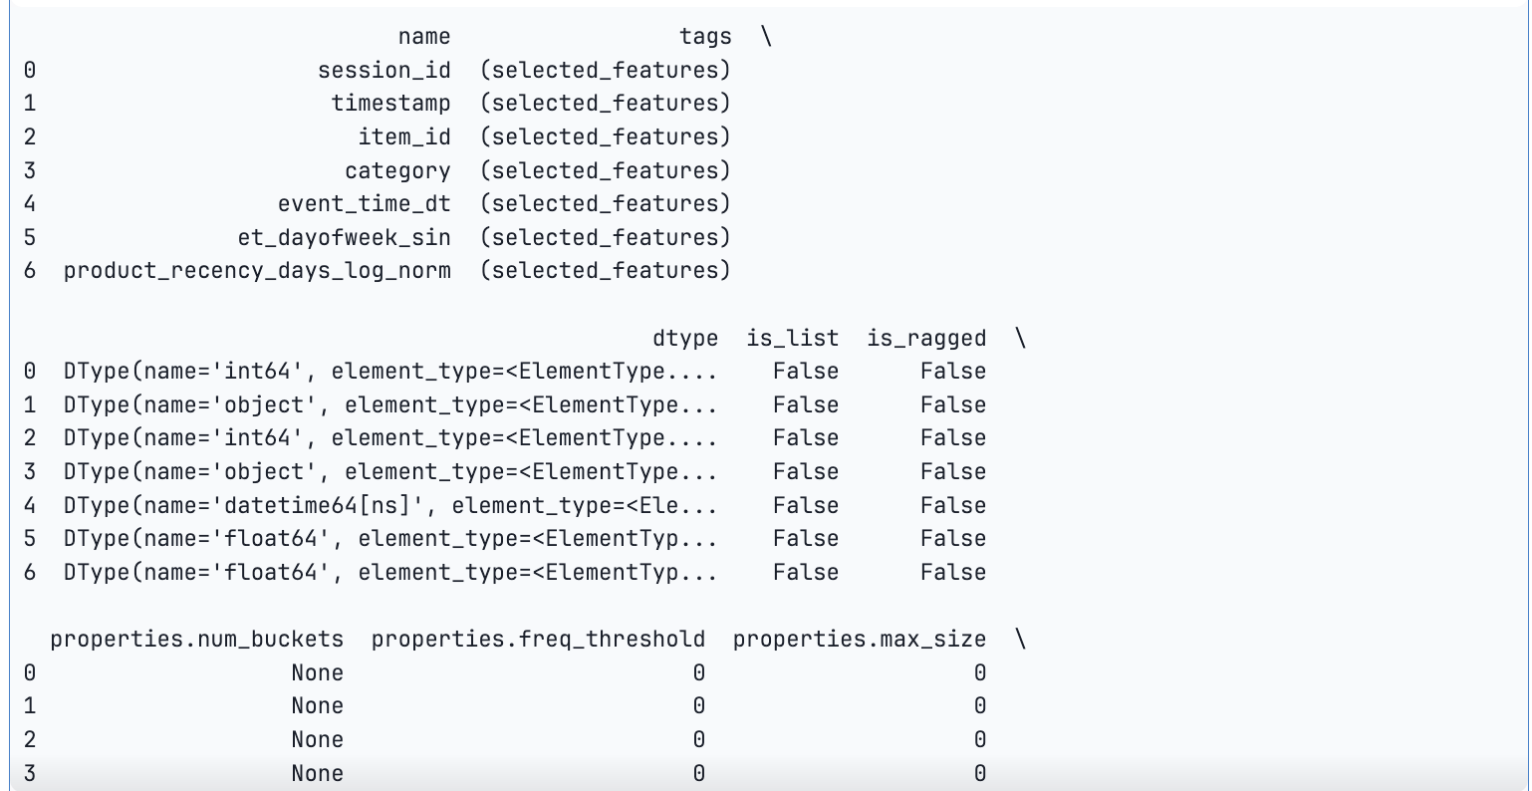

Slide 27

Advance of parquet
High Storage Efficiency
Compression Support: Parquet natively supports multiple compression algorithms (such as Snappy, Gzip, Zstd, etc.), significantly reducing storage space. Data can typically be compressed to 1/5 to 1/10 of the size of a CSV file. Example: A 10GB CSV file might only require 1GB of storage space when saved as a Parquet file.
Efficient Data Reading
Advantages of Columnar Storage: Parquet files store data by columns rather than rows, meaning you can directly read the columns of interest without having to load the entire dataset. This provides significant performance advantages when filtering and analyzing specific columns in large-scale datasets. Example: When reading a specific column in a CSV file, you must parse each row of the entire file, while Parquet only needs to access the relevant column blocks.
Faster Query Performance
Optimized Query Performance: Parquet supports Predicate Pushdown, which allows data filtering at the storage layer, reducing unnecessary data loading. It is ideal for distributed query processing in big data frameworks such as Apache Spark or Hive. Example: When querying data within a certain timestamp range, Parquet can directly skip unrelated data blocks, while a CSV file would need to scan everything.
Rich Data Type Support
Built-in Data Types: Parquet supports more extensive data types (such as DATE, DECIMAL, BOOLEAN, ARRAY), unlike CSV files which only support strings and numbers. It is more suitable for scenarios such as machine learning and recommendation systems, which require strict data types. Parquet supports nested fields, allowing it to store complex data structures like nested arrays or structs directly.
Distributed Computing Friendly
Support for Parallel Processing: Parquet files can be partitioned and directly support distributed computing frameworks (such as Apache Spark, Dask, and NVTabular). Multiple nodes can load different partitions simultaneously, making full use of computing resources.
Better Data Consistency
Strong Data Format Constraints: Parquet files have clearly defined schemas, and data is checked against this schema when loaded. CSV files typically lack strict format constraints, which can lead to errors due to inconsistent data formats.
High Integration
Widely Supported: Parquet files can be read by most mainstream data tools, including:
Python (pandas, cudf, pyarrow, etc.).
Distributed systems (Apache Spark, Dask, Presto, etc.).
Data warehouses (Snowflake, BigQuery, Hive, etc.).
More Suitable for Machine Learning and Large-scale Recommendation Systems
Fast Loading: The columnar storage and compression of Parquet files can significantly accelerate data loading, especially in large-scale data processing.
Efficient Storage of Features: In recommendation systems, it is often necessary to process features that contain nested lists (e.g., user click sequences). The support for nesting in Parquet makes storing such features more efficient.

Slide 28
Step 5: Organize Feature Structure
5.2 NVTabular Workflow Saved to Disk for Reuse
Save the NVTabular workflow to disk for reuse without redefining or retraining global statistics such as categorical dictionaries, means, and standard deviations.

Slide 29
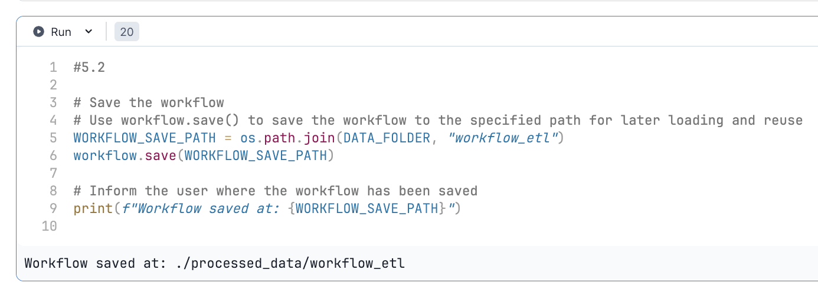
Benefits of Saving the Workflow:
Reusability: The same workflow can be applied to different datasets (e.g., test set, prediction dataset). This avoids recomputing statistical information, thereby improving efficiency.
Consistency: Ensures that the same feature engineering logic and statistical parameters are consistently applied to the training set, validation set, and test set.
Ease of Deployment: The saved workflow can be used in an online inference service, directly loaded to process real-time data features.
Suitable for Distributed Computing: In a distributed environment, each node can load the same workflow to achieve consistent data processing.

Slide 30
Step 6: Session-Level Data Processing
6.1 Process Session-Level Data
Split processed data into training, validation, and testing datasets, proportionally divided by day.
Aggregate each session to generate sequence features, focusing on item interactions, temporal features, and categorical features.
Identify feature types, including categorical features, continuous features, and target labels.
6.2 Simplify Data Splitting
Use the save_time_based_splits function to split the dataset by time (based on timestamps and partition columns) and save it to the specified output directory.
Simplify splitting and saving logic using Transformers4Rec and NVTabular's efficient data processing capabilities.
6.3 Release GPU Memory

Slide 31
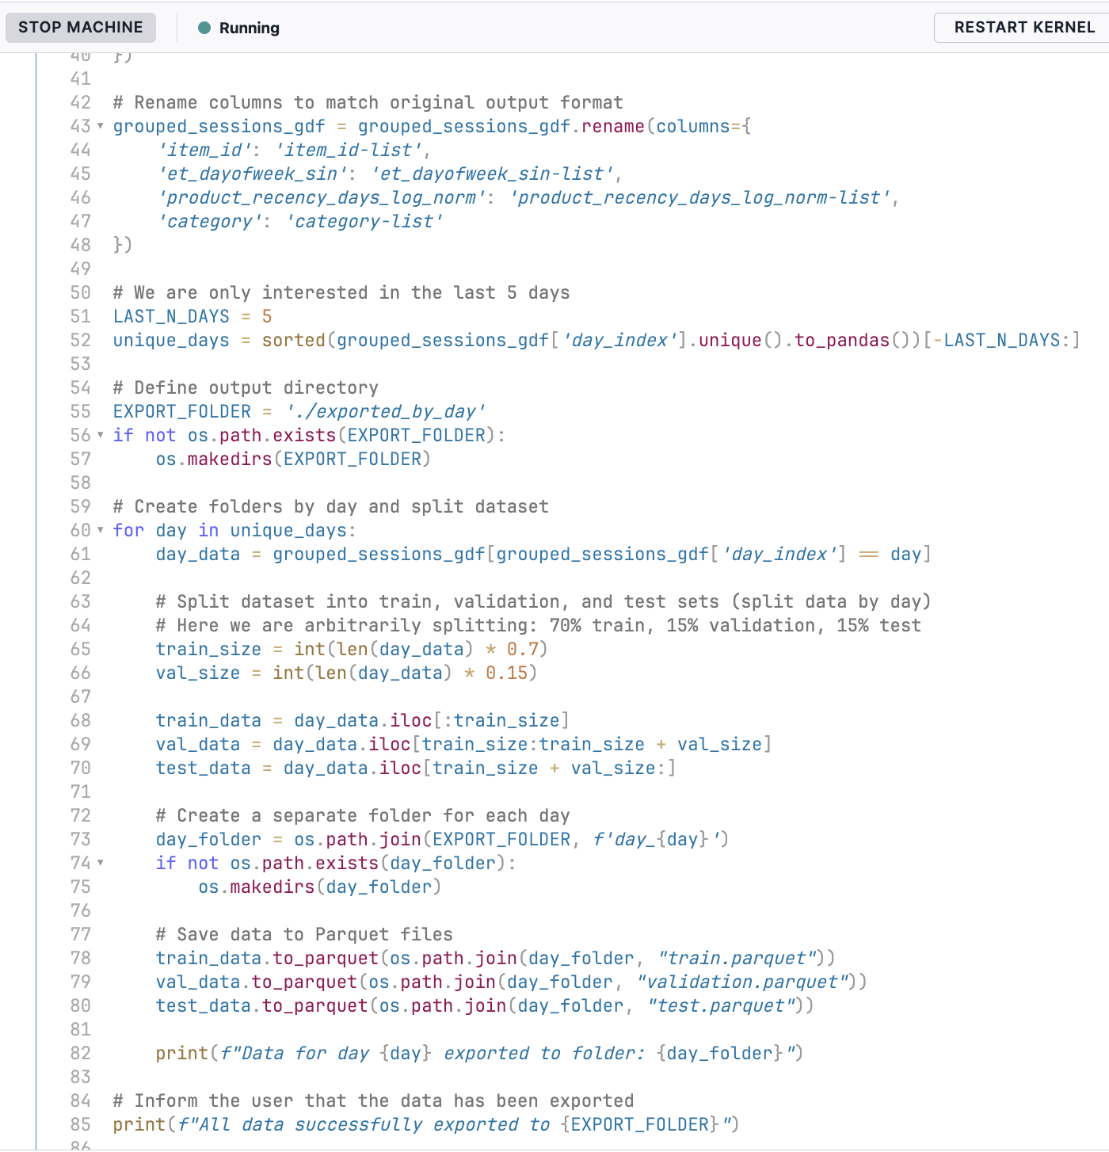
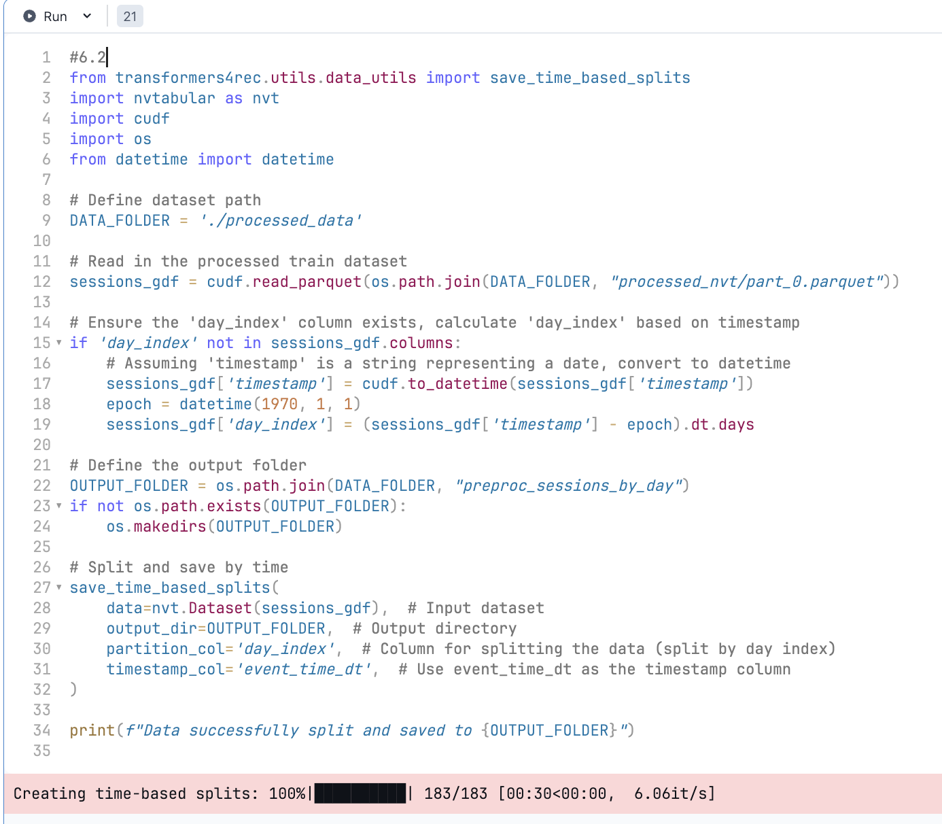
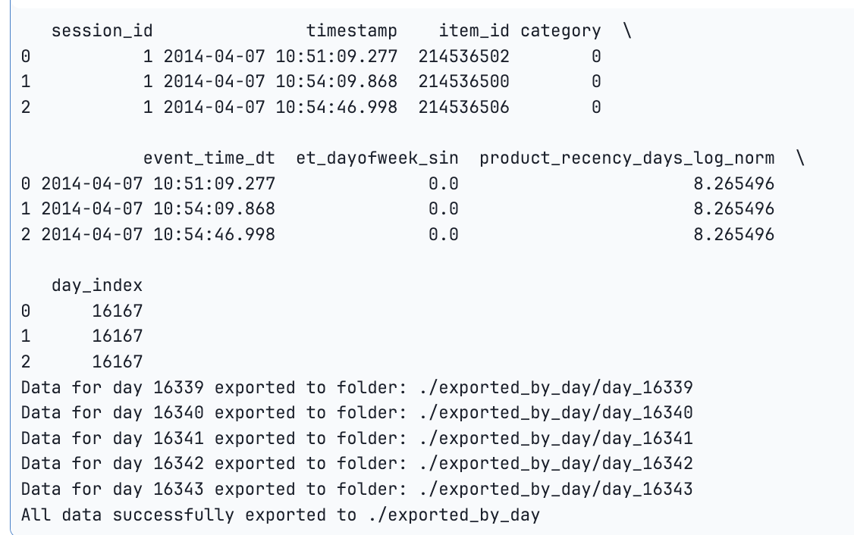

Slide 32
Step 7: Training Data Preparation and Model Fine-Tuning
7.1 Prepare Training Data
Use Merlin's data loading tools for efficient large-scale data processing with GPU acceleration.
Operate on data metadata using schemas without directly manipulating raw data, simplifying feature selection.
7.2 Model Construction
Use TabularSequenceFeatures to support serialized feature inputs.
Define NextItemPredictionTask for predicting the next item in a sequence.
Use XLNet configuration to define transformer model parameters.
Combine input modules, prediction tasks, and transformer configurations into an end-to-end model.
7.3 Define Training Parameters and Initialize Trainer
Set key parameters for model training and validation (e.g., batch size, learning rate, number of epochs).
Optimize data loading with GPU support via Merlin.
Enable FP16 precision for faster training.
Use the Transformers4Rec Trainer class to instantiate an end-to-end trainer combining the model, schema, and training parameters.

Slide 33
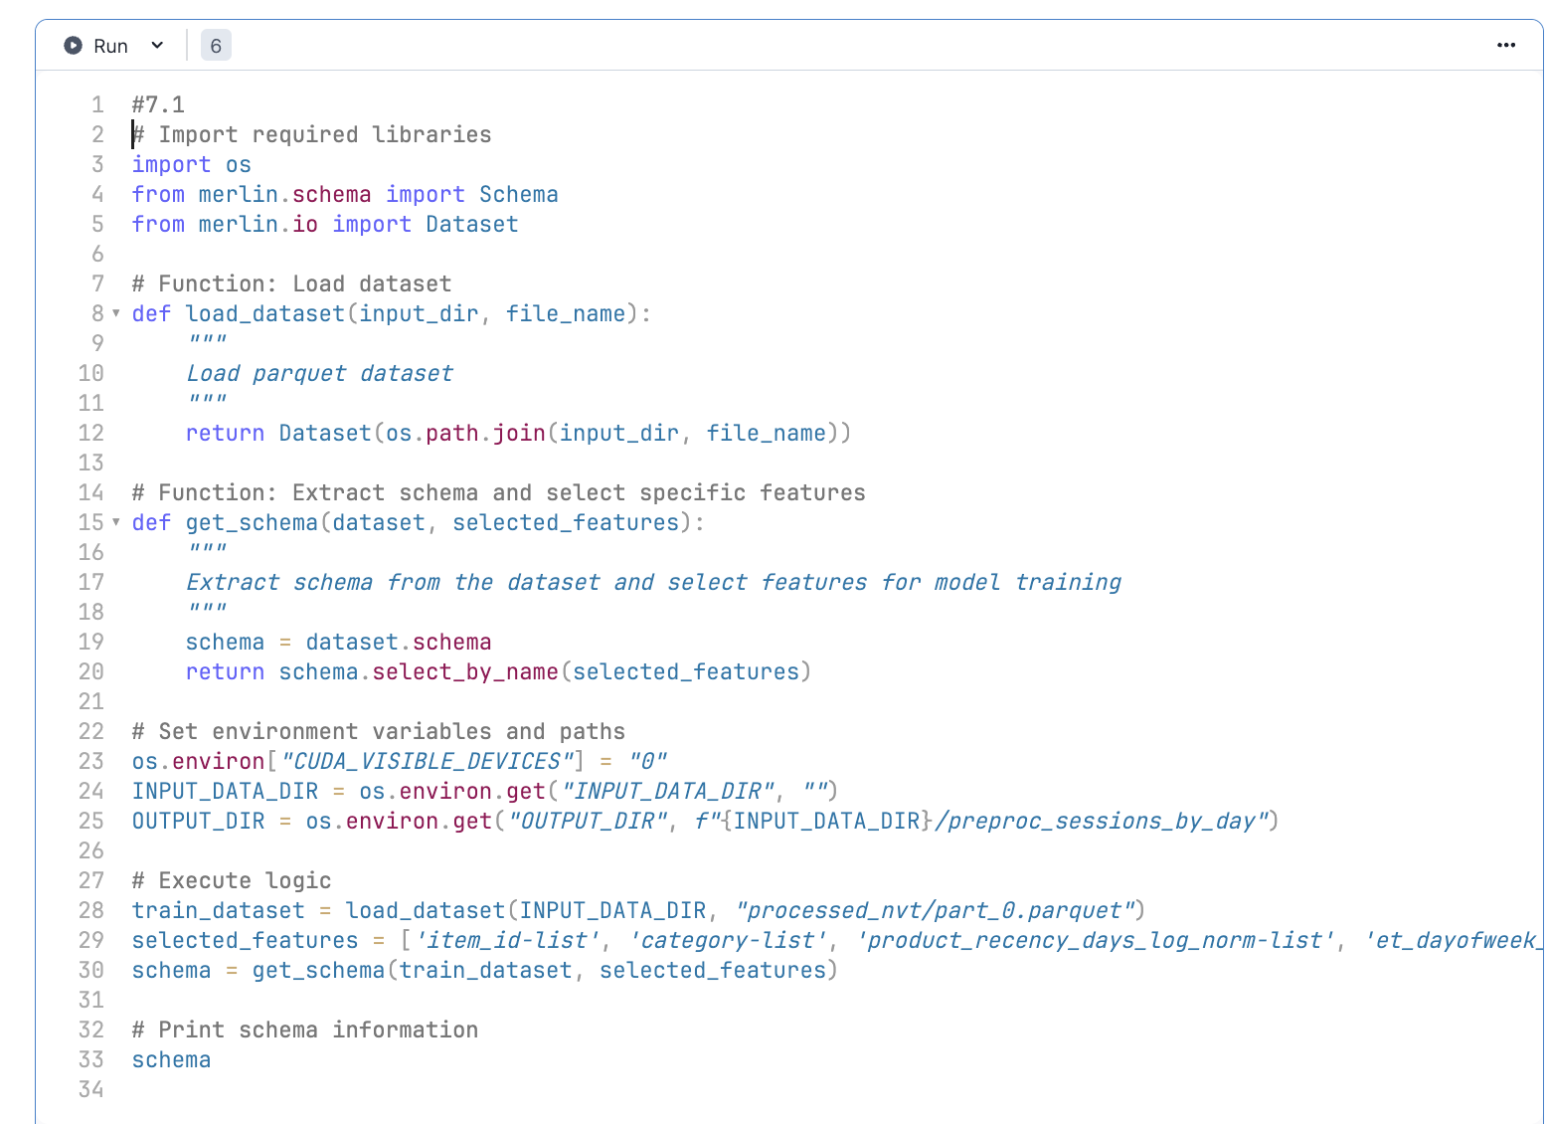
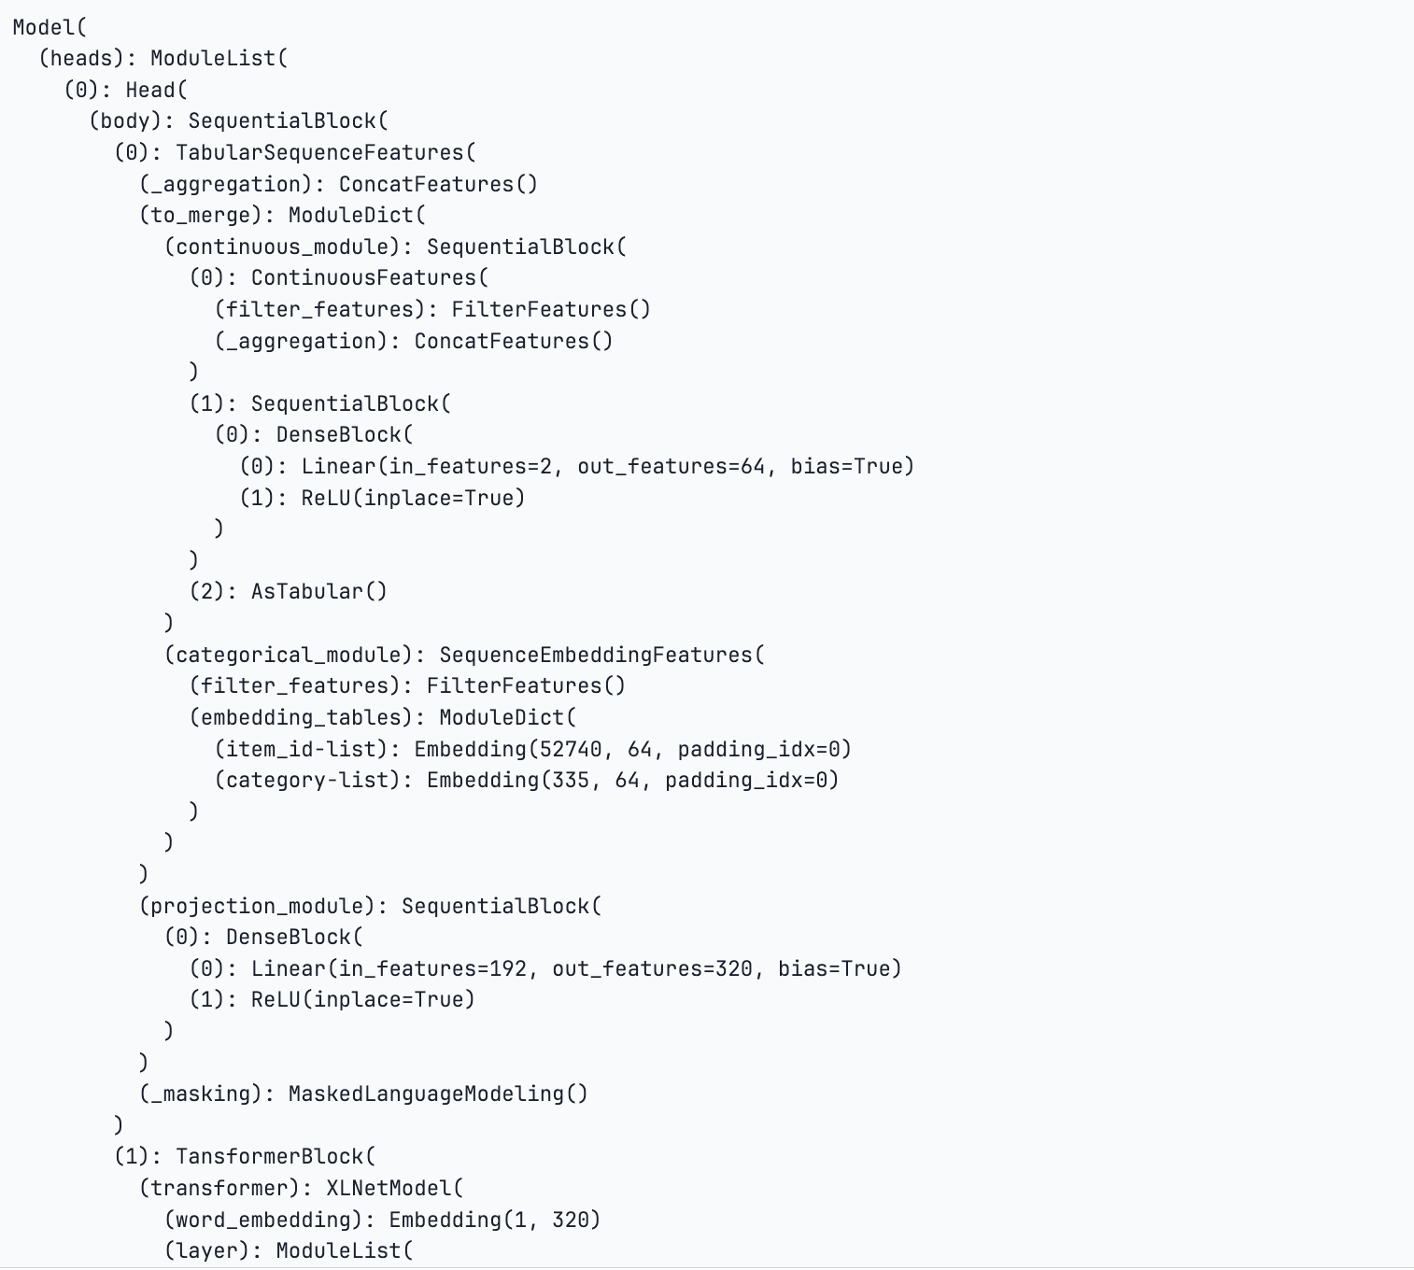
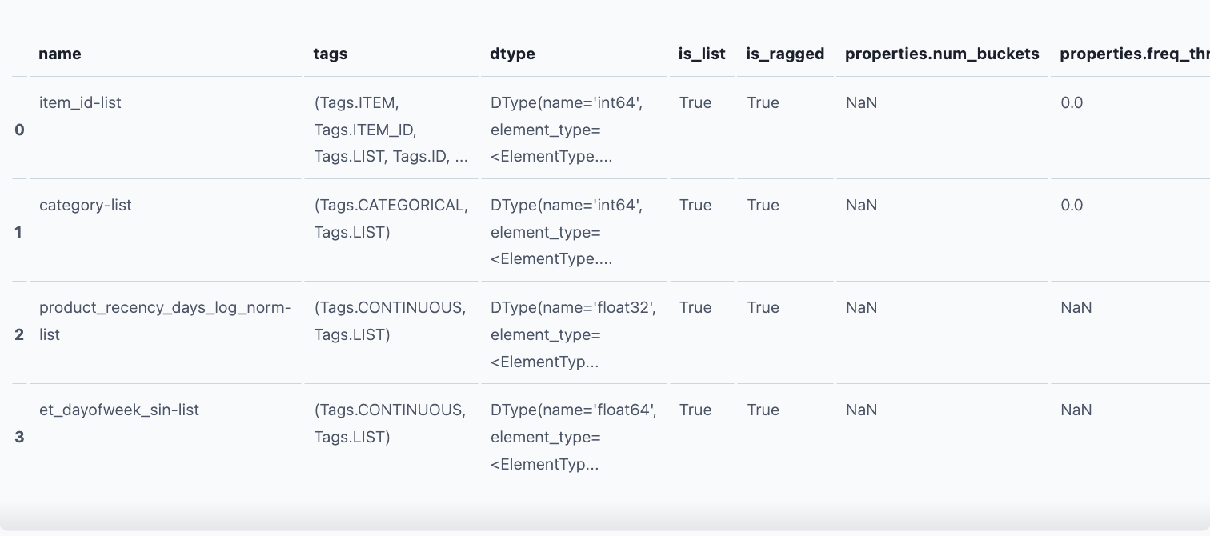
Output of 7.2 model construction

Slide 34
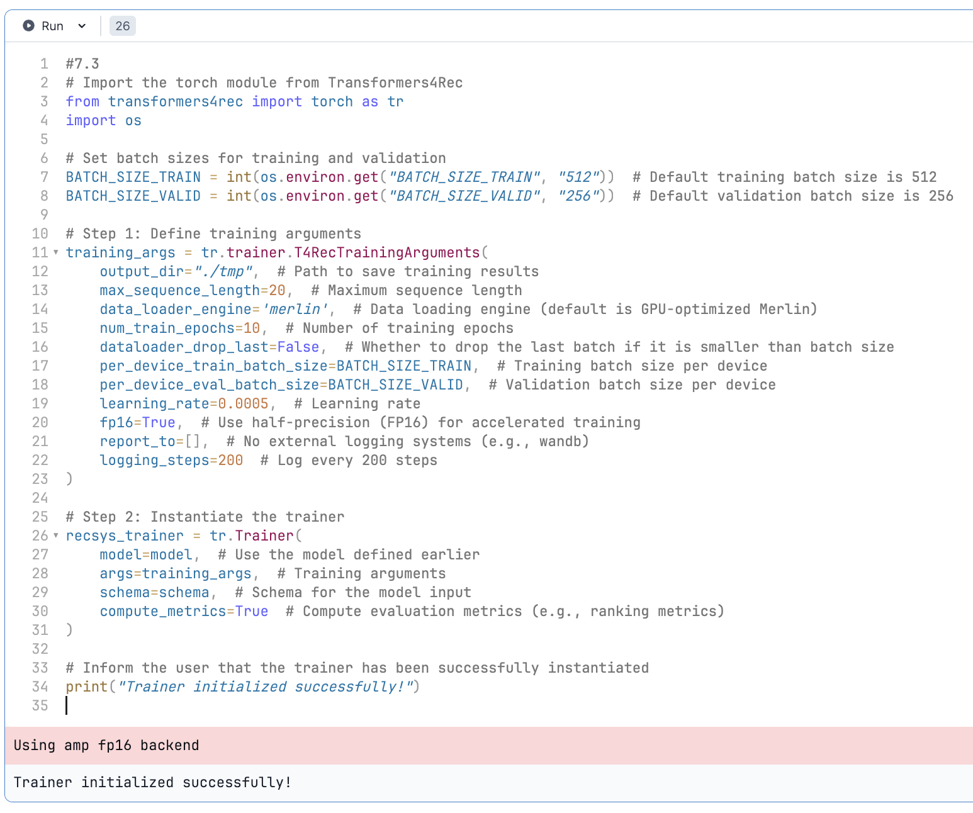

Slide 35
Step 7: Training Data Preparation and Model Fine-Tuning
7.4 Start Daily Fine-Tuning and Evaluation
Use the fit_and_evaluate method for time-window-based fine-tuning and evaluation of the recommendation system.
Key Components:
recsys_trainer: A trainer instance containing the model architecture, optimizer, and other training settings.
start_time_index and end_time_index: Define the time range for training and evaluation.
input_dir: The input data directory, typically storing preprocessed data.
Perform data loading, model training, and evaluation for the specified time range.
Return OT_results with detailed training and evaluation metrics.
7.5 Visualize Evaluation Metrics Over Time
Compute average scores for each evaluation metric over time from OT_results.
7.6 Trace the Model
Validate the model inputs and trace the model using torch.jit.trace.
Construct input dictionaries to ensure proper input formatting.
Confirm that offsets in item_id-list__offsets are generated and passed correctly.

Slide 36
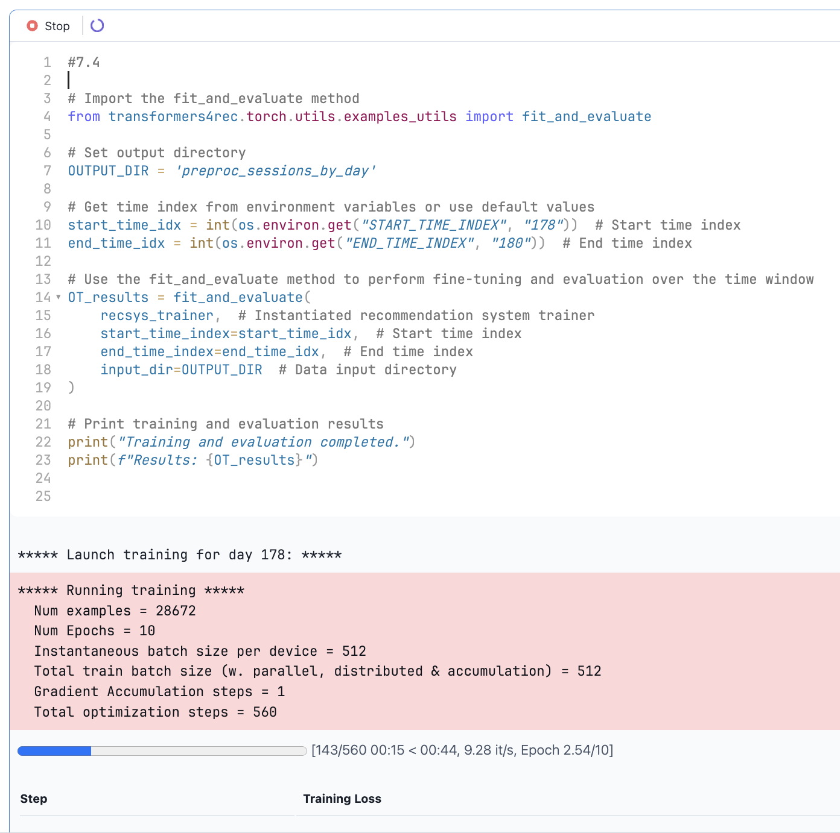
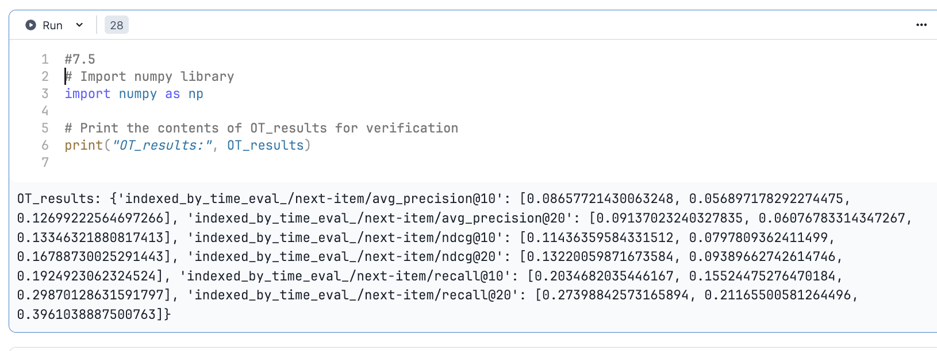
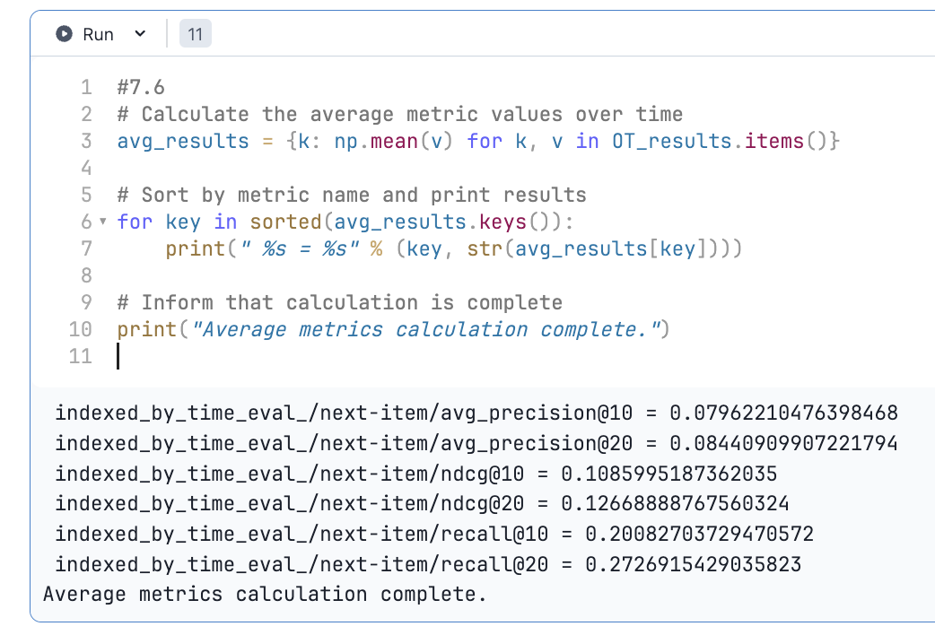
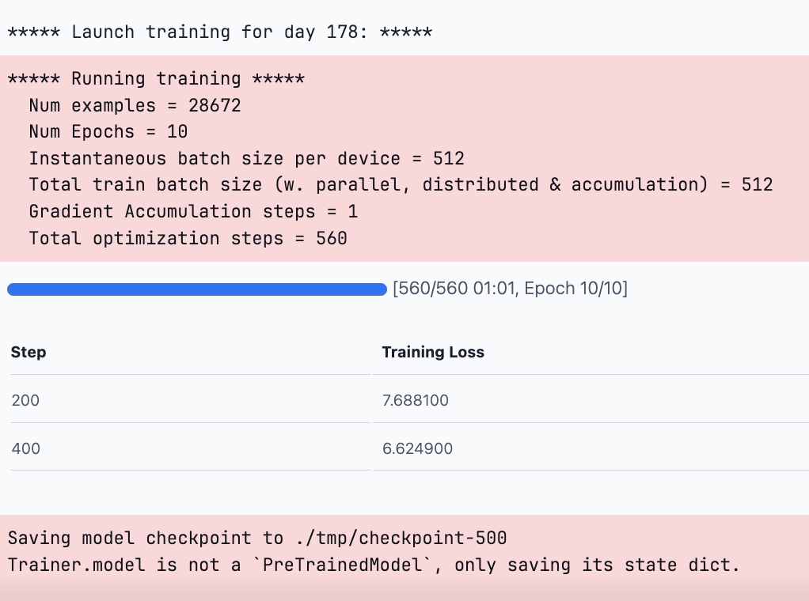

Slide 37
Step 7: Training Data Preparation and Model Fine-Tuning
7.7 Build an Inference Operation Graph
Integrate the feature engineering workflow and PyTorch model into an inference pipeline.
Store the operation graph at a specified path to facilitate online inference for the recommendation system.

Slide 38
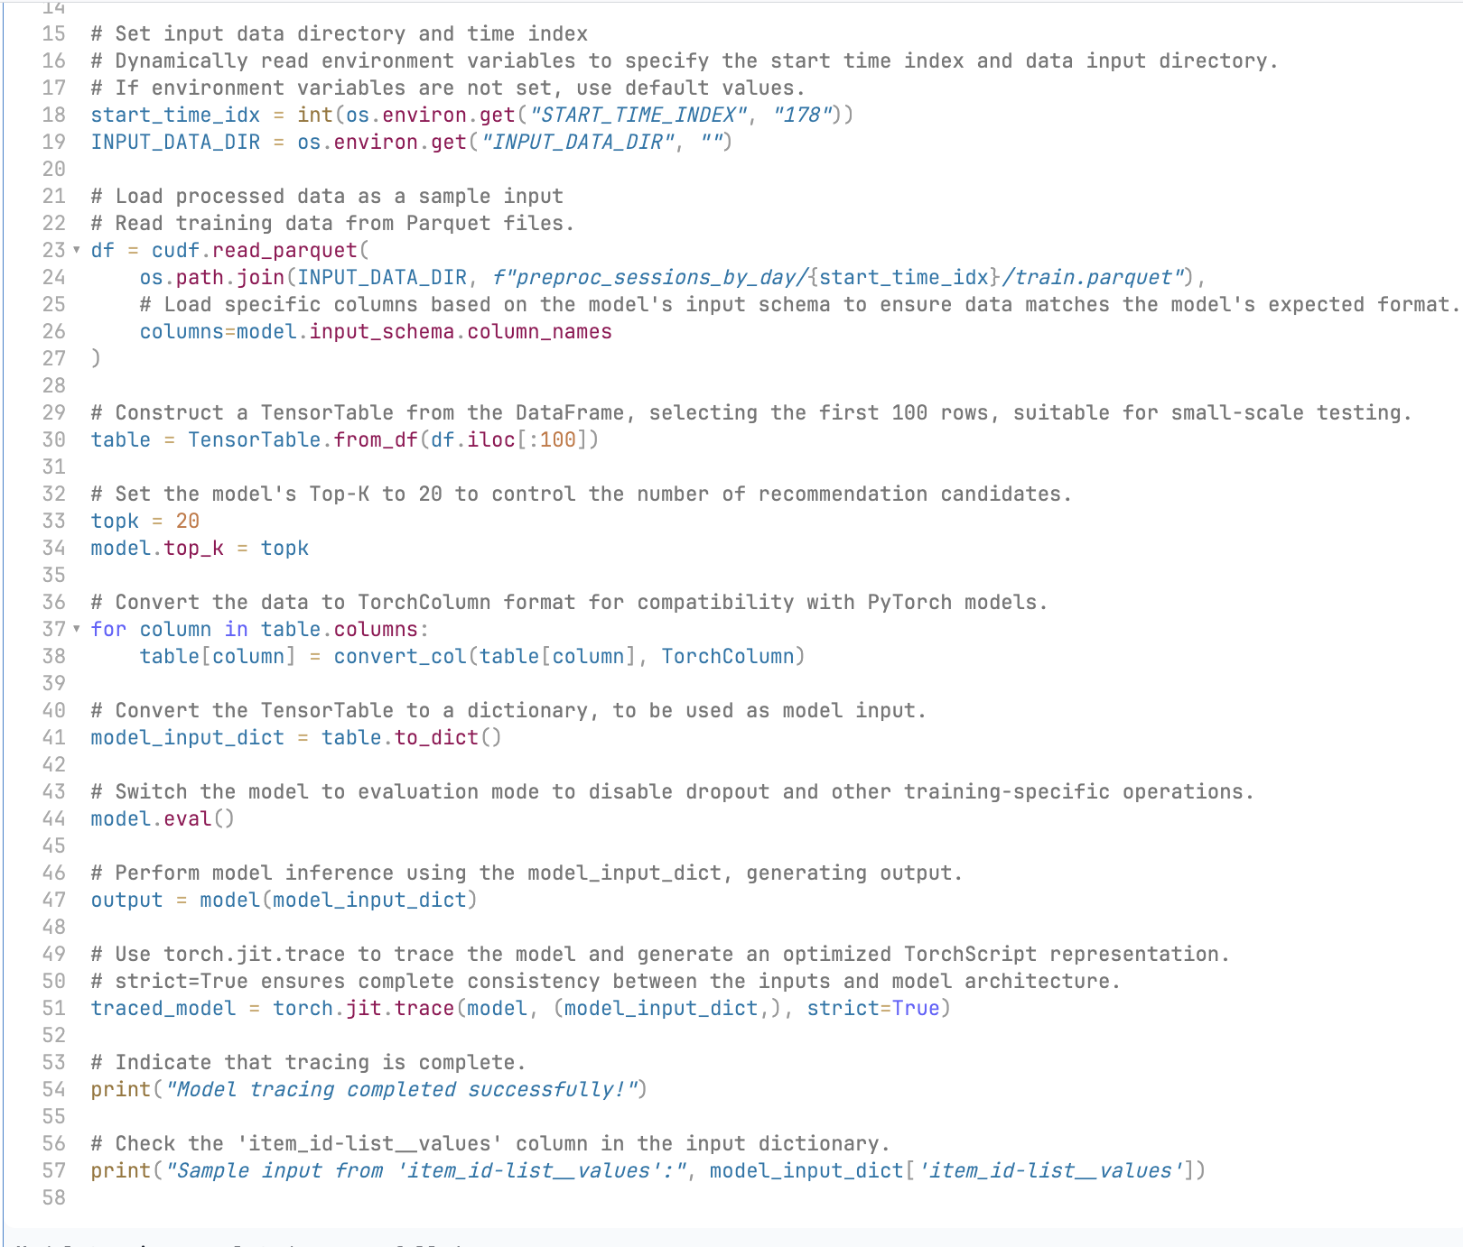
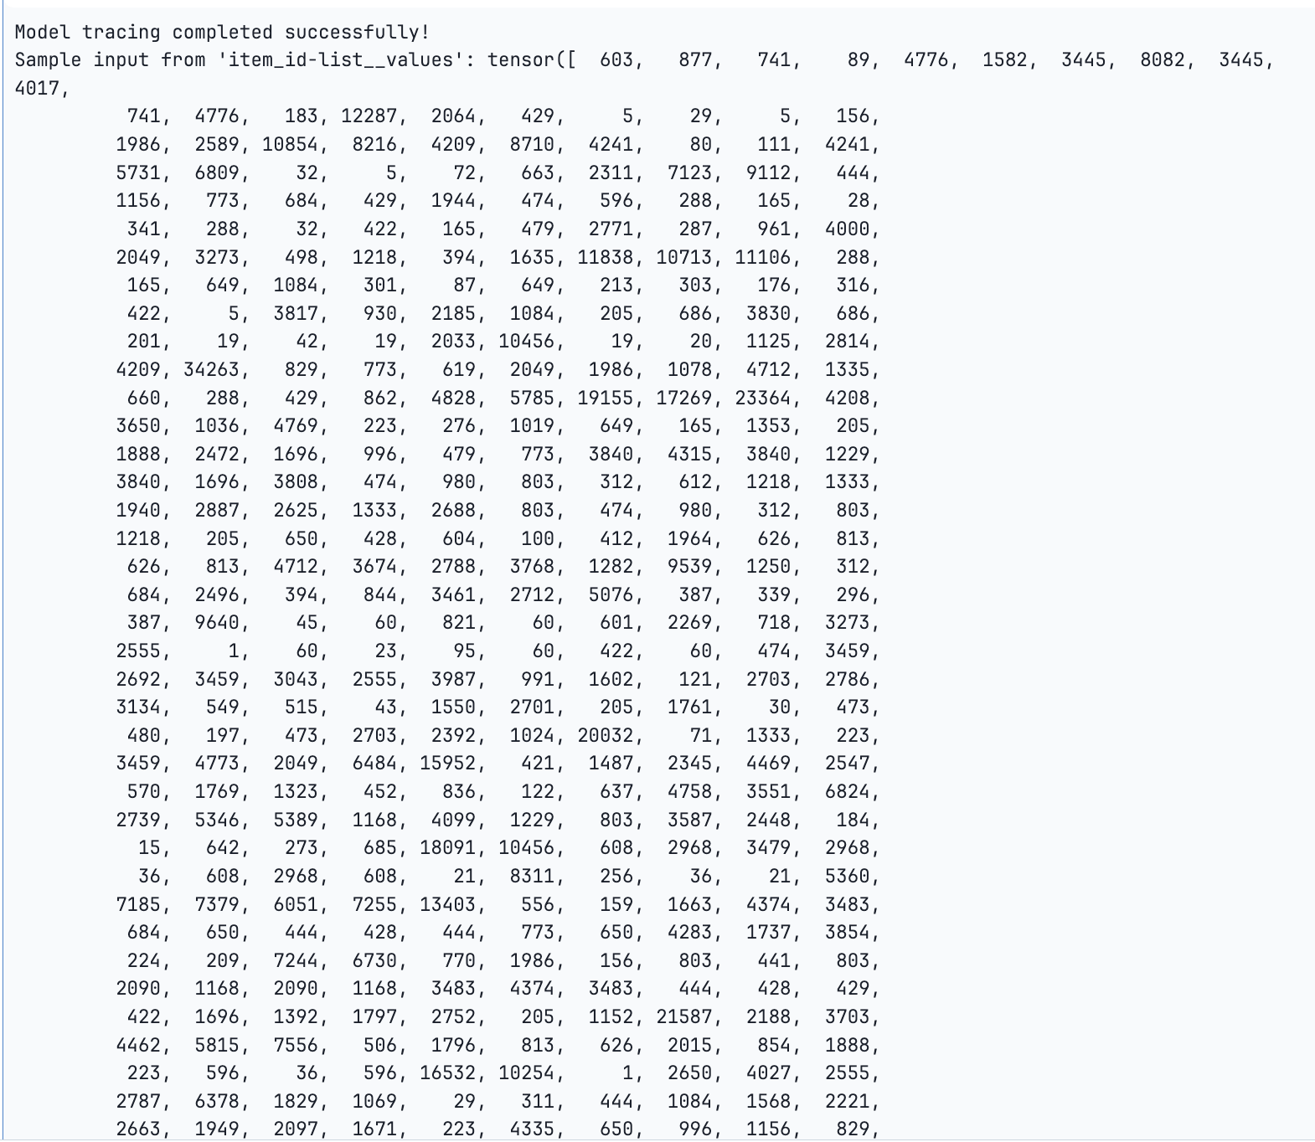
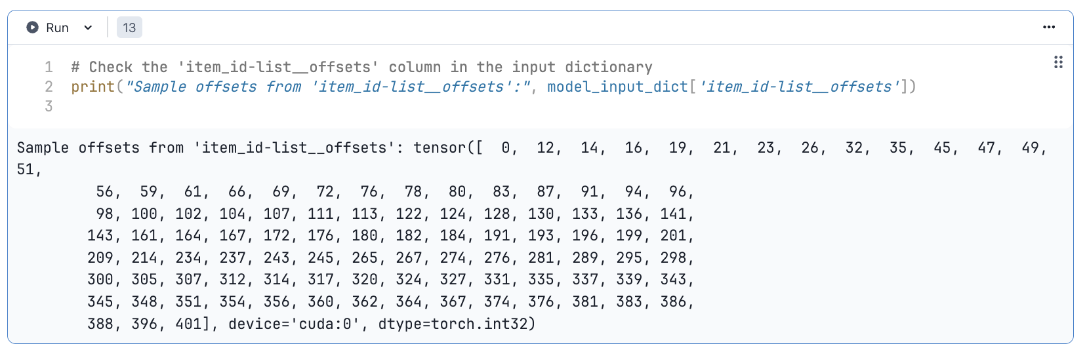
Check the 'item_id-list__offsets' column in the input dictionary

Slide 39
Step 7: Training Data Preparation and Model Fine-Tuning
7.8: Constructed an Inference Operation Graph
An inference operation graph was built to integrate the feature engineering workflow and the PyTorch model into a unified inference pipeline.
It is stored at a specified path, providing the foundation for online inference in the recommendation system.

Slide 40
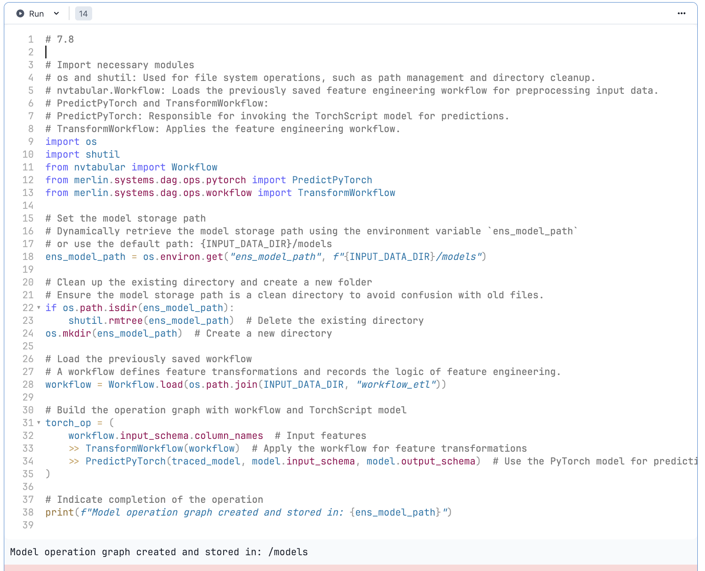

Slide 41
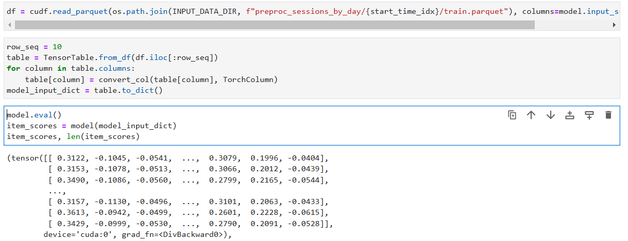
Step 8: Attack model
8.1: store the parameters
store the model parameters when transformer4rec model overfitting.

Slide 42
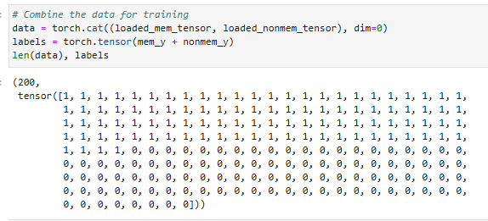
Step 8: Attack model
8.2: label the mem and nonmem dataset
label the mem data as 1.
label the nonmem data as 0.
Notes:
after load the parameter, i need label it for attack training, here i label training data as 1, label nontraining data as 0.

Slide 43
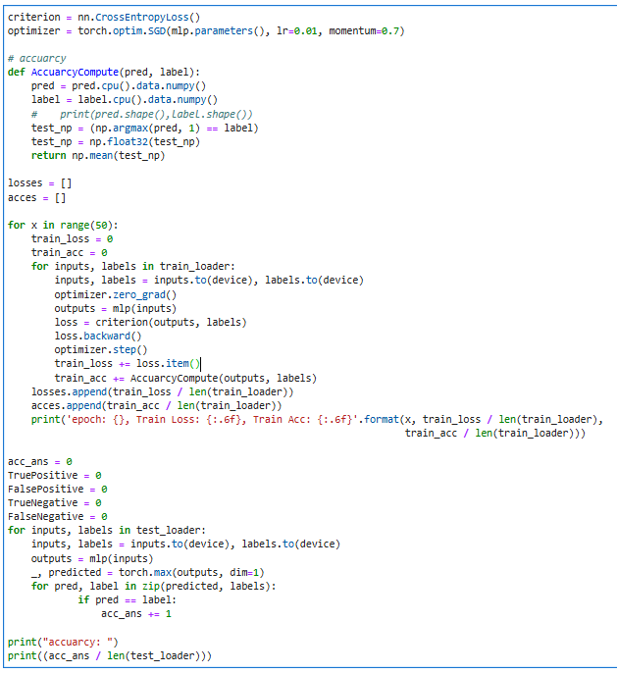
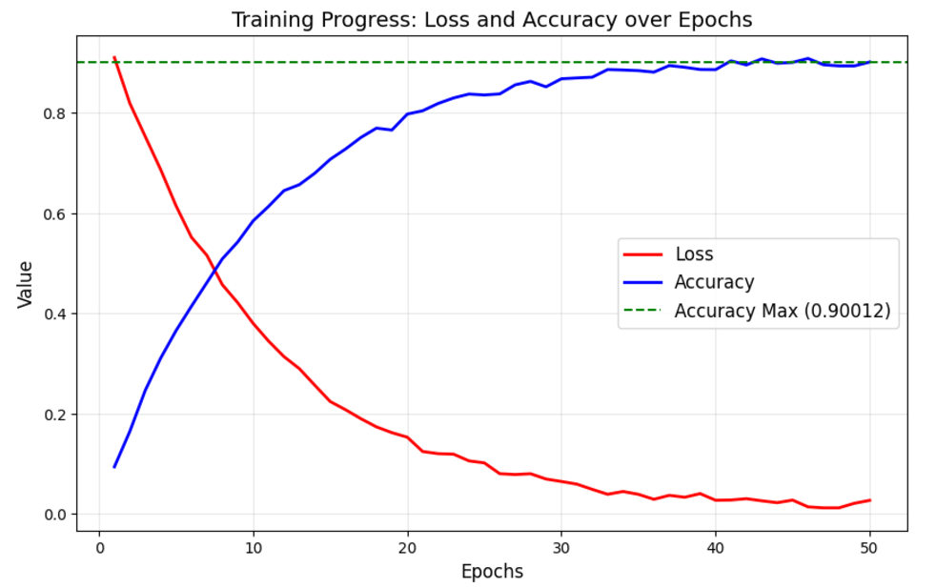
8.2: train and adjust the attack model
Step 8: Attack model
Notes:
based on the dataset, we train our general classification model, and the right picture shows our attack model learn well with the data and achieve high acurray.

Slide 44
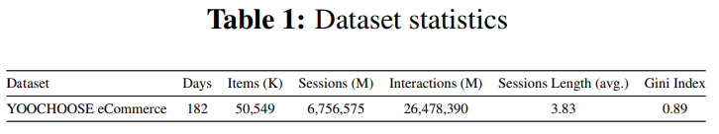
Experiment setting
Dataset Statistics(YooChoose)
Running Environment(paperspace)
NVIDIA GPUs & NVIDIA Merlin libraries (e.g., NVTabular, HugeCTR) for large-scale data processing.
Baseline Model
Biased-MIA is the frst algorithm to implement MIA against the recommender system. They identify users through the diference between user historical behaviors and the recom mendations provided by the target model.
DL-MIA improved Biased-MIA by debiasing learning. They design a disentangled encoder and a weight estimator to simultaneously mitigate training data and estimation biases.
Notes:
now i done the pipline of our method. And i move on the experiment, here i firstly introduce the experiment setting.

Slide 45
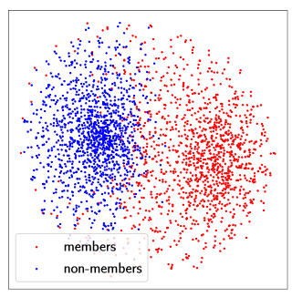
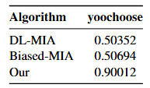
Results
Attack performance (AUC) over sequential recommenders
visualization the output of transformer4rec results by t-SNE, where red points denote members and blue points represent non-members
Notes:
as for the result, the left picture shows the xxx, from the picture we can know the distribution is different between mem and nonmem, that’s means our method can lean the difference and classify the training and nontraining efficiently. the right picture shows the attack auc over xxx, our method achieves higher auc than other baseline model.

Slide 46
Discussion and Takeaways
Our proposed method introduces a novel and effective approach to membership inference attacks in sequential recommenders by leveraging the distinct output distribution differences caused by overfitting.
Explore the how to inial mia attack on the similar sequences.

Slide 47
Any Questions?

Slide 48
Thank You

